Slide 1

Cuppa and Chat
19th March 2025
Welcome!
Thank you for popping along today – it’s lovely to meet you! ☺
Please take a moment to sign in, grab a cuppa and snack…

Slide 2
Introductions….
House keeping….
What Cuppa and Chat is….
Plan for this session…..to celebrate grandparents/ carers…to learn what we can do to support you / to share useful tools with you

Slide 3
Thank you! You make a huge difference to our families and community….
Who are you? Who do you support? What does that support look like?
What’s tricky? What might you want to know about school life here? Any worries or concerns which we can help with?

Slide 4
Supporting you to support your young person…it takes a village….
You are part of the Marchwood Family! Please reach out when you need to! Don’t wait until situations escalate.
You can talk to a huge number of people depending on what your concern is:
Our office team/ Class teacher/ LSA/ SENCO/ ELSA/ Welfare/ MHWB Lead/ SLT – we always have staff on the gate on the mornings too….and we’re there at the end of the day ☺
Cuppa and chat sessions – you are always very welcome to any sessions we run
MHWB newsletters (these are emailed to parents but are available on our website)
Website – there is a wealth of information and support there – well worth a delve into!
We are an MHST school and can refer children to their service – we would need parental consent to do this, but if you are concerned about your grandchild, have a conversation at home to start the process
There are lots of local support groups available which we can direct you to – info on board in entrance foyer – please fee free to screen shot/ jot down info/ take a flyer
Speakers/workshops eg Lorraine Lee – again, very welcome to attend – especially useful if you’re looking after children for big chunks of time. Information goes out to parents, but is also on our noticeboard out the front of school.

Slide 5
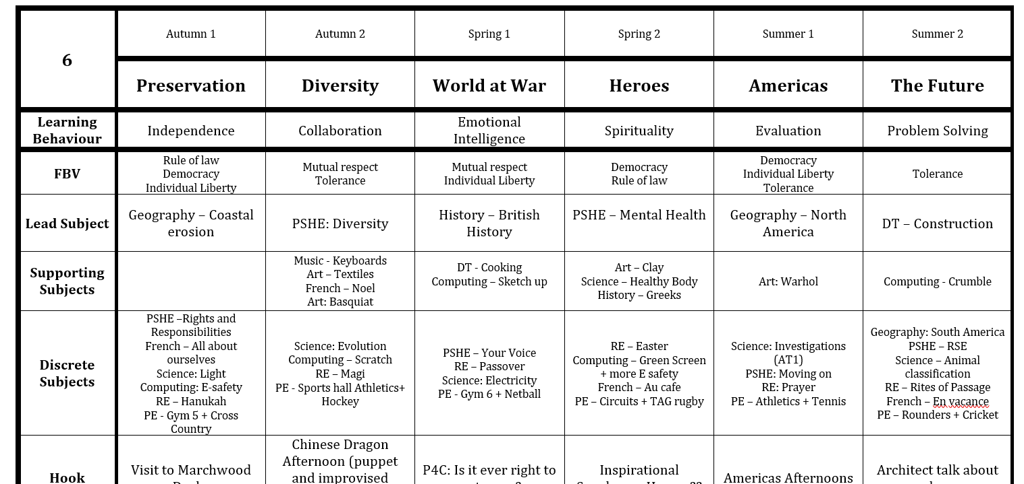
https://www.marchwood-jun.hants.sch.uk/
Our Website…..let’s take a look….
Staff – contacting staff / values
What are children studying?
I need help with maths strategies….
Homework
Useful websites
* Wellbeing….

Slide 6

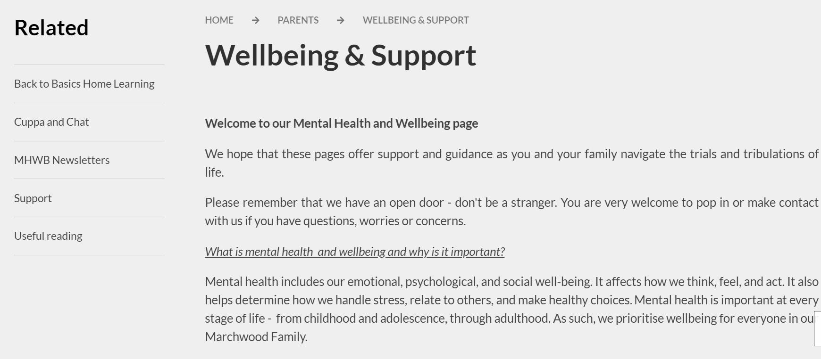
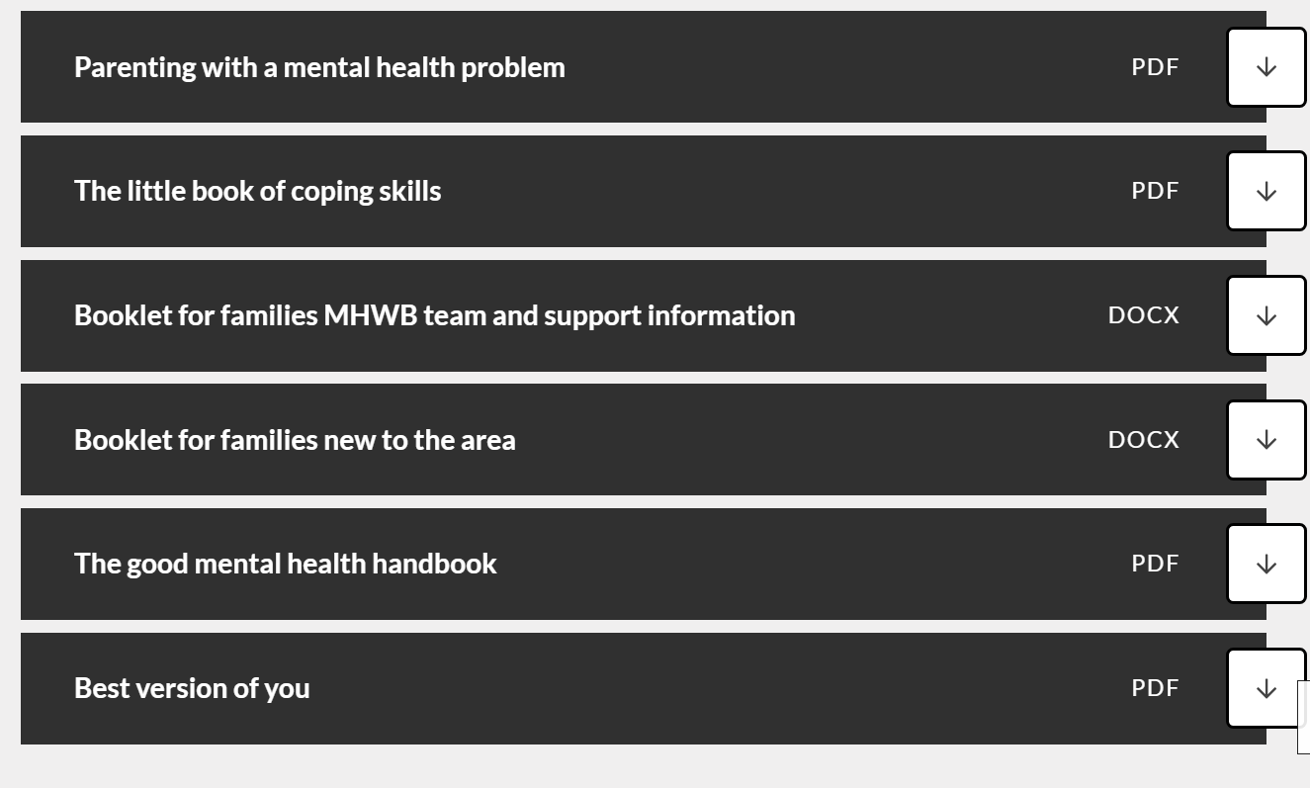
Wellbeing…
You will find previous Cuppa and Chat presentations here too.

Slide 7
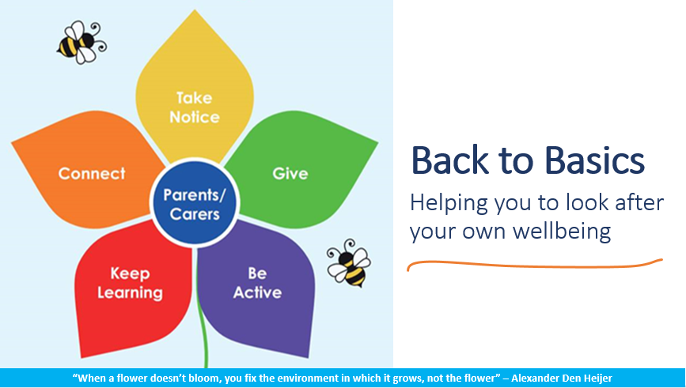
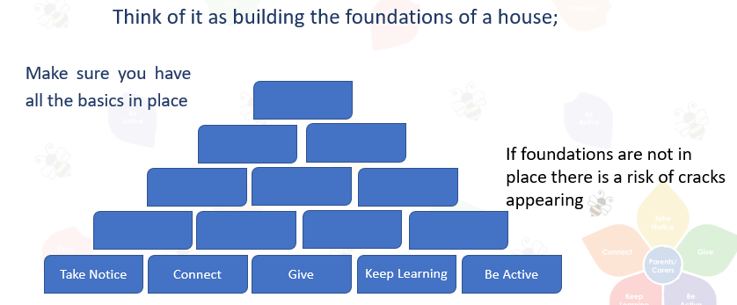
Prevention and support

Slide 8
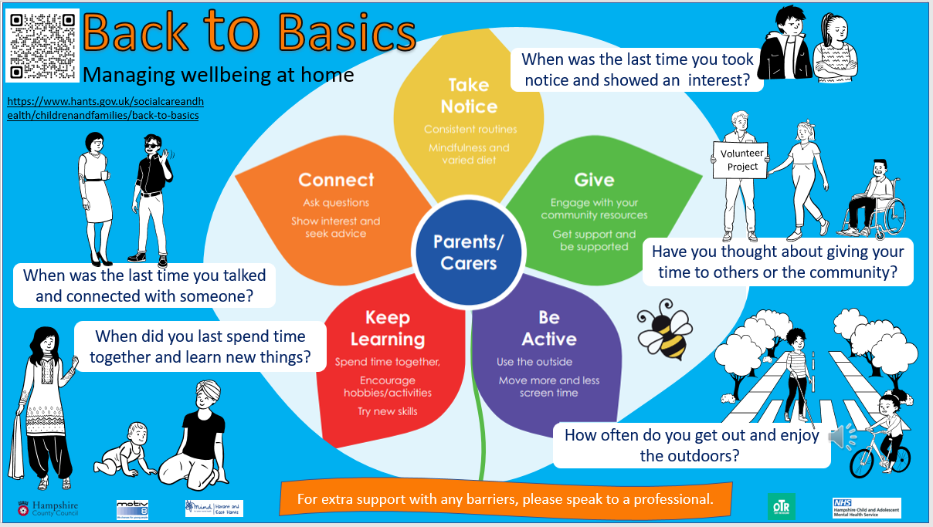

Slide 9
B2B - good wellbeing strategies for the whole family!
Information is on our website and on the Hampshire website too – along with resources.
We promote B2B at school – half term challenges along with specific focus weeks – please encourage your young people to participate (you could join into!)
Create small achievable targets together – then build on your success….insistent, consistent, persistent… If you’re caring for a child where parents are trying to focus on an area, make sure you’re on board too, so that you’re all singing from the same hymn sheet.

Slide 10


Look on the Hampshire CAMHS website, under the parent/ carer tab and ‘events’ tab – there is wealth of information available

Slide 11

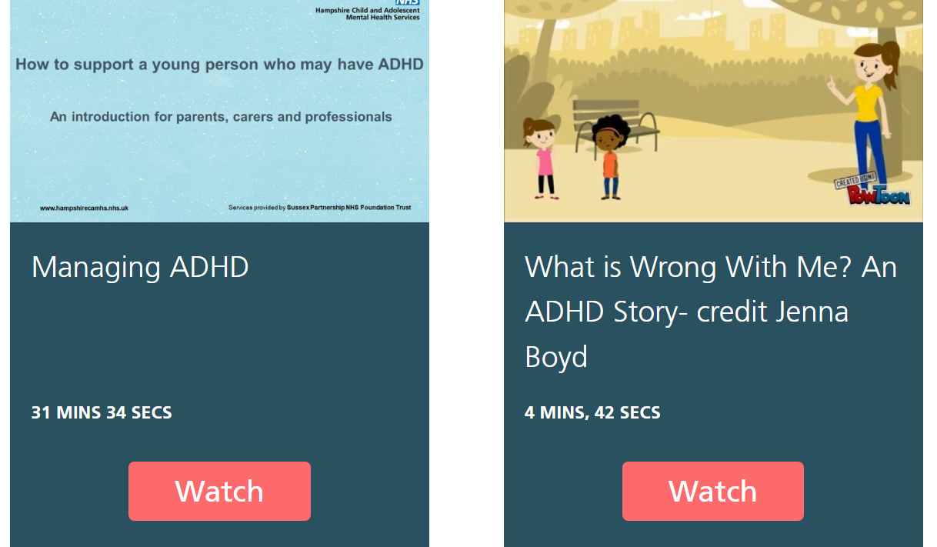

Slide 12
Questions?
Worries?
Positive experiences / things that work for you which you are happy to share?
Interested in helping out at school? Eg listening to readers etc?

Slide 13
Please take a flyer – any feedback is appreciated – especially direction for future themes for Cuppa and Chat ☺

