Slide 1

Cuppa and Chat
25th September 2024
Welcome!
Thank you for popping along today – it’s lovely to meet you! ☺
Please take a moment to sign in, grab a cuppa and snack…

Slide 2
Introductions….
House keeping….
What Cuppa and Chat is….
Plan for this session…..

Slide 3
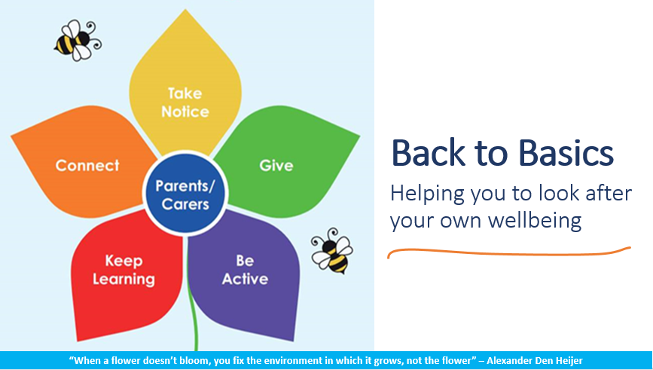
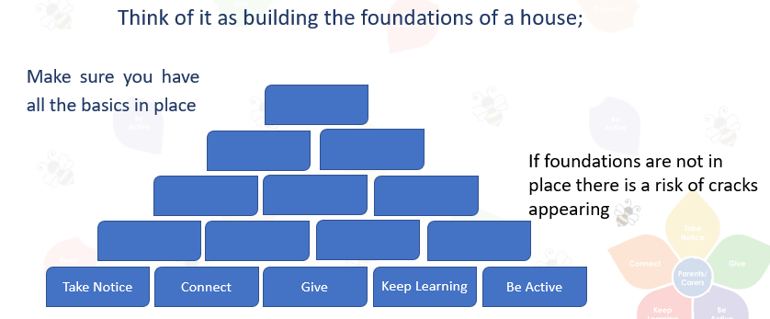
Prevention and support

Slide 4
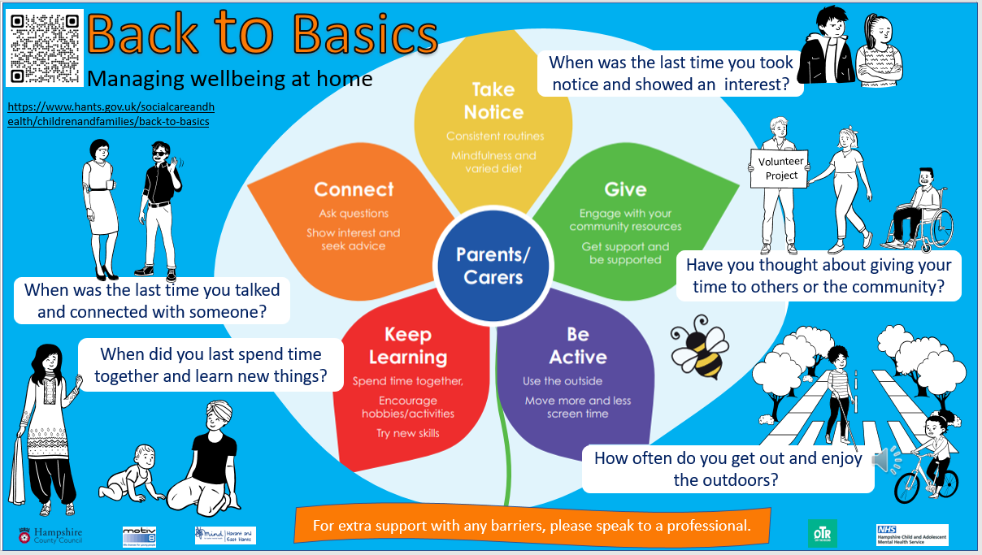

Slide 5
Good wellbeing strategies for the whole family!
Information on our website – or talk to myself or your child’s teacher. Information and resources on the Hampshire website too.
Create small achievable targets together – then build on your success….fair, consistent, persistent.

Slide 6
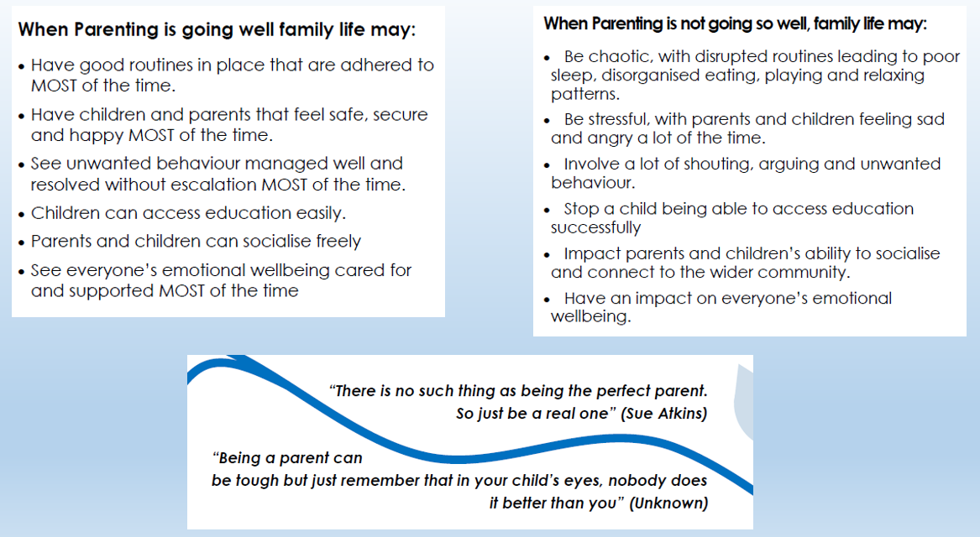

Slide 7
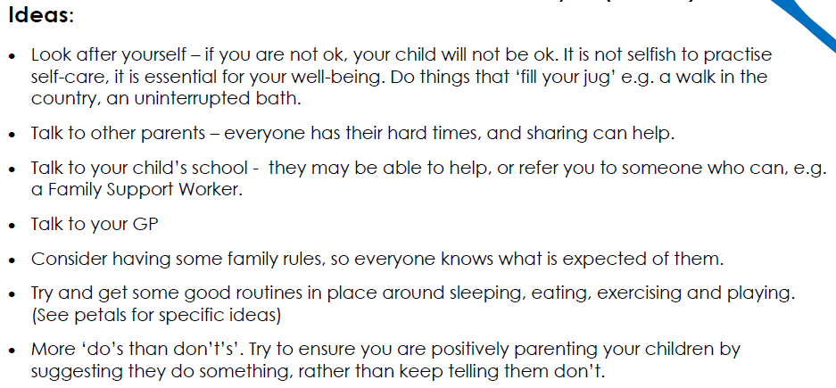
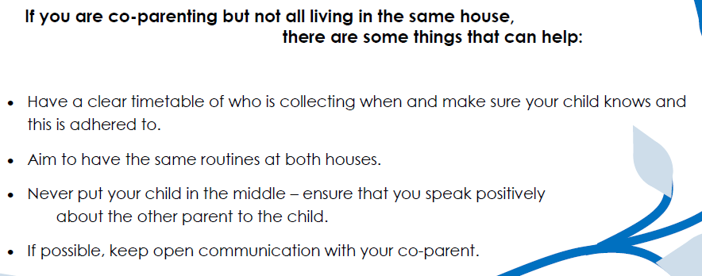
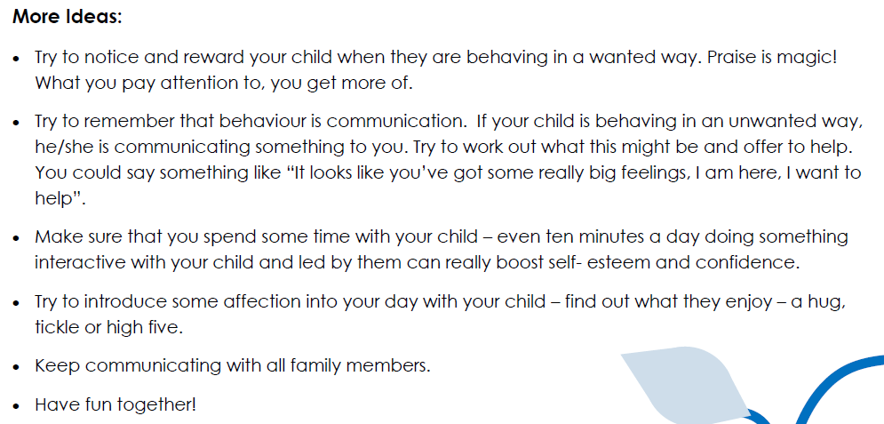
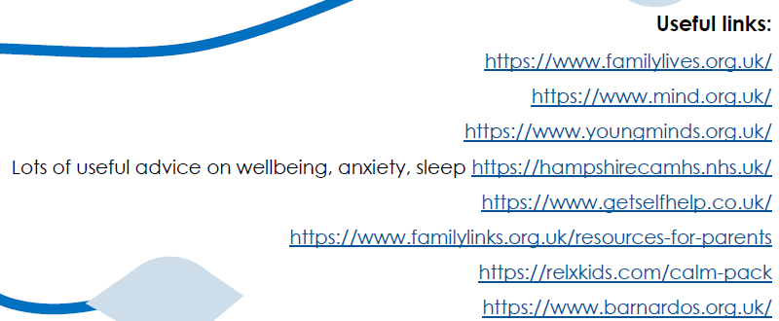
Back to Basics is all about creating the best possible foundations so that you can deal with the ups and downs of life ☺

Slide 8
In school and out of school support…
You are part of the Marchwood Family! Please reach out when you need to! Don’t wait until situations escalate.
You can talk to a huge number of people depending on what your concern is:
Our office team/ Class teacher/ LSA/ SENCO/ ELSA/ Welfare/ MHWB Lead/ SLT – we always have staff on the gate on the mornings too….and we’re there at the end of the day ☺
Cuppa and chat sessions – MHWB newsletters
Website – there is a wealth of information and support there – well worth a delve into!
We are an MHST school and can refer children to their service
There are lots of local support groups available which we can direct you to – info on board too.
Speakers/workshops eg Lorraine Lee / MHST sessions

Slide 9
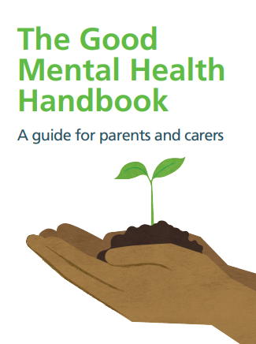
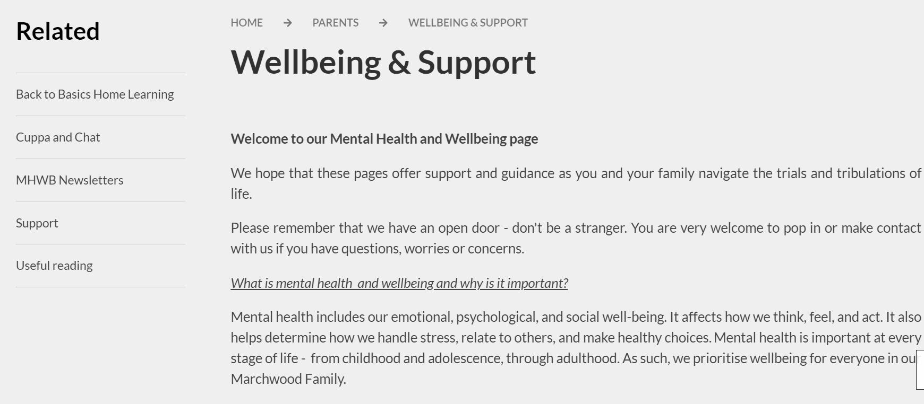
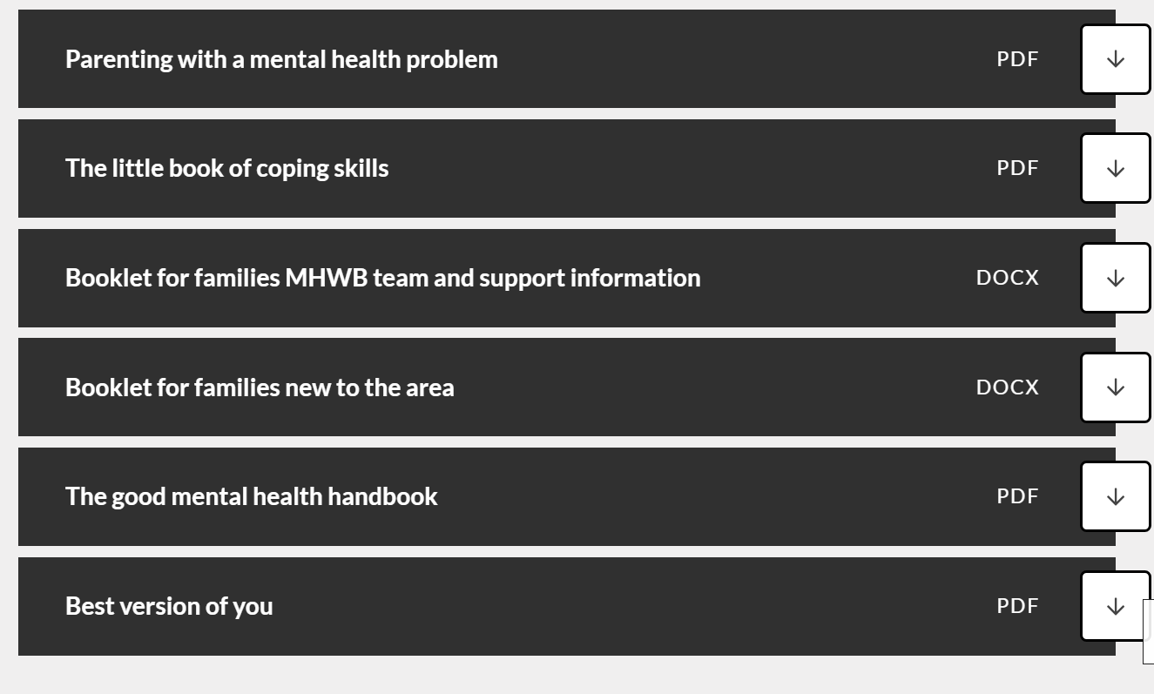
Our website…
You will find previous Cuppa and Chat presentations here too.

Slide 10
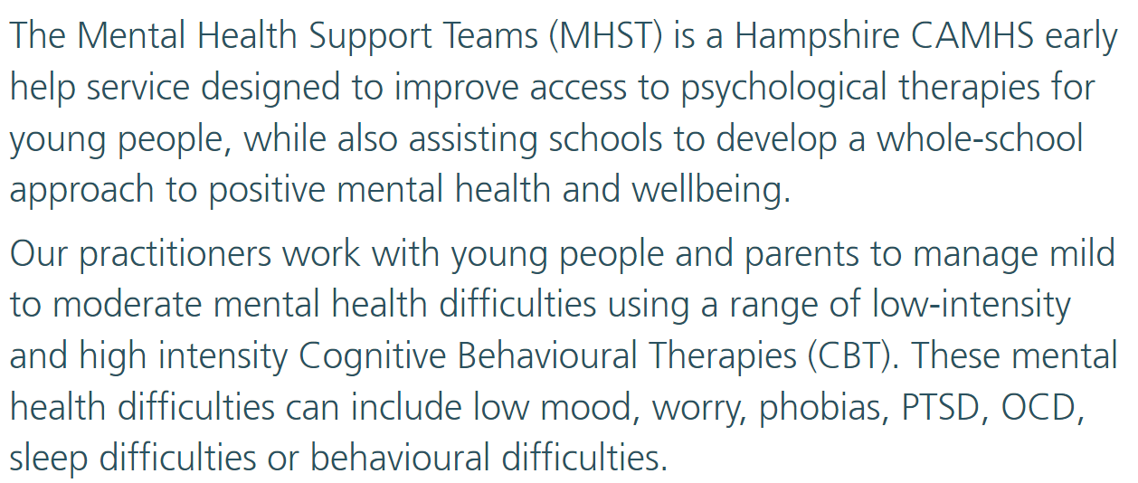
MHST

Slide 11
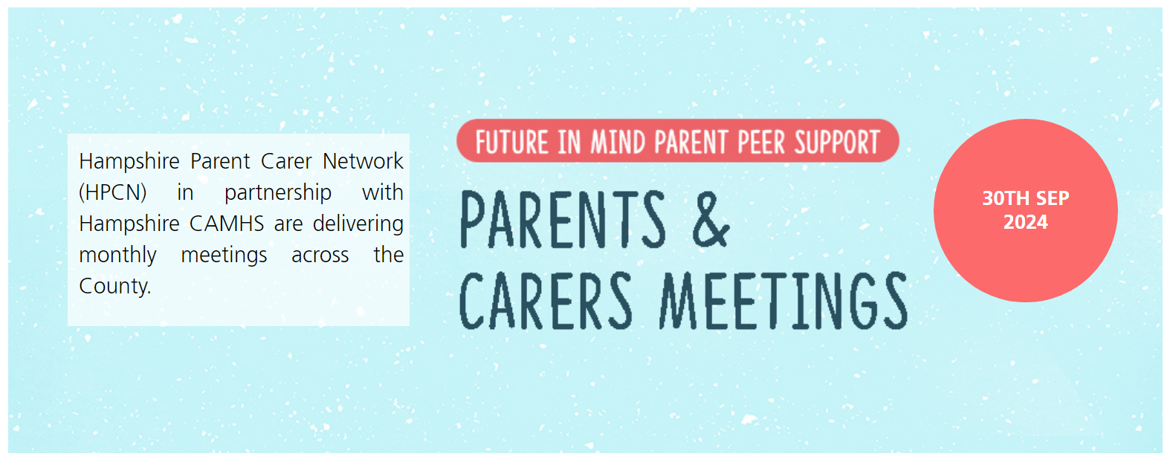
Look on the Hampshire CAMHS website, under the parent/ carer tab – there is wealth of information available

Slide 12


Slide 13


Slide 14

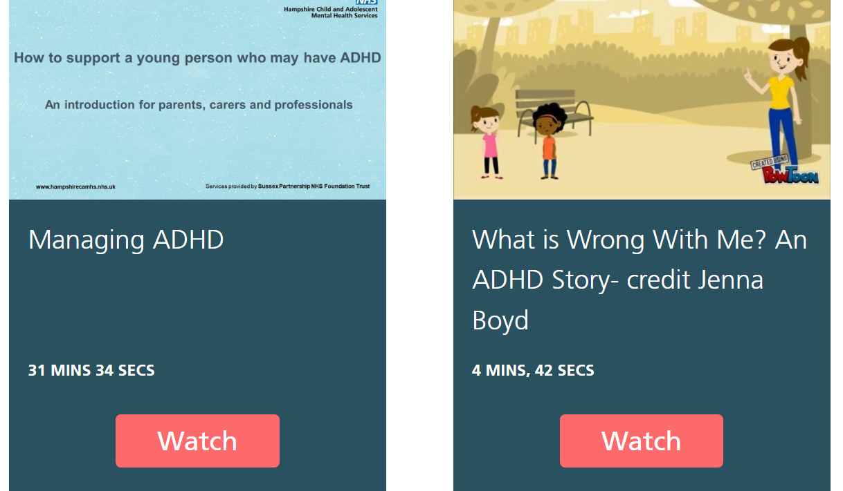

Slide 15
MHWB newsletters
Every half term you will be emailed our MHWB newsletter. This is full of ideas, information, thoughts, current research etc which you might find helpful for your family!
Children will also be set challenges to help them to embed the 5 ways of wellbeing ☺

Slide 16
Parent Forum:
How can we support you and your family?
This is SO important. We need to know what you need and then we can work on it!
Add ideas onto the paper – if you have a thought later, please drop me an email!

Slide 17
1. Ask for help if you think your child needs it
Dr Moses says your child might also be upset when they come out of school if there were any difficulties that day that weren’t addressed, or there’s something unresolved that’s happened.
2. Let them have decompression time
Dr Moses suggests having a think about what your child needs when they come out of school.
"Do they need to go and run around the school playground a few times and let go for a bit before they walk home? Do they need movement or do they need a healthy snack? Or quiet time alone with no music or no chatting on the way home in the car or bus?"
It will be different for different kids, but Dr Moses suggests trying to be quiet on the walk or ride home.
"Connect with your child. Not by asking ‘how was your day?’ but through genuine emotional connection. You could say ‘I’m so happy to see you, I’m glad we get to go home together, it made me happy coming out of school this way’. Being calm and using supportive words is important for your children."
She adds: "Include some downtime rather than moving straight on to homework or out to a club, so that your child can decompress. They might enjoy their clubs but still feel anxious, so build in downtime first and make their routine clear, visual and written down if they need that.
A new year…
How has your child/ children settled?
After school…
Picture the scene: your child comes out of school and the teacher says they’ve behaved like the perfect child all day, but the moment you get home they have a complete meltdown. Your child screams, shouts, lashes out, sulks or generally acts in an unruly manner.
If that scene is familiar to you, you’re not alone. This type of behaviour is what some psychologists refer to as ‘after-school restraint collapse’ and it’s not unusual. It happens because your child has been busy managing their emotions all day as they navigate the complexities of school life.
When they get home, that’s their safe space to let it all out!
So, now you know what it is, what can you actually do about it? Parents’ Toolkit has been speaking to educational and child psychologist Dr Anisa-Ree Moses, for some tips on how to support these outbursts of emotions after-school.

Slide 18
3. Listen to them and help them feel heard
"Be understanding of their emotions - help them feel listened to if they want to talk about what’s gone on, or be angry."
"You could say ‘I can see you’re shouting. I can see you want to be really loud, maybe let's go to the park on the way home’. Validate how they feel rather than try and control it. If they are impolite in the moment, come back to that later – talking at that moment won’t help.”
“Help them feel listened to and respected and make a genuine connection.”
Dr Moses says the after-school ‘meltdown’ is an expression of emotion that often comes out physically. As parents you can recognise and label it so your child can see if for what it is.
4. Build in time for connection
Connection is a great way for your child to know they’re loved and that you’re there for them, no matter what.
It could be snuggling up in bed, reading a book together, playing a quick game, or just having a chat.
Dr Moses suggests thinking about what your morning routine is like: “Is there anything you can build in there that can help them feel connected to you? I know this can be hard, I know how frustrating and annoying school runs can be! Let them know you’re looking forward to seeing them later, just for who they are, not for what they’ve achieved.”
5. Understand how hard school can be for some children
Dr Anisa-Ree Moses says that children can feel emotional, physical and mental exhaustion at the end of the school day. They have been trying to manage a mix of things like learning, social expectations, their own growing social awareness and all the feedback they’re getting from teachers and peers.

Slide 19
Please take a flyer – any feedback is appreciated – especially direction for future themes for Cuppa and Chat ☺

