Slide 1

Cuppa and Chat
27th November 2024
Welcome!
Thank you for popping along today – it’s lovely to meet you! ☺
Please take a moment to sign in, grab a cuppa and snack…

Slide 2
Introductions….
House keeping….
What Cuppa and Chat is….
Plan for this session…..

Slide 3
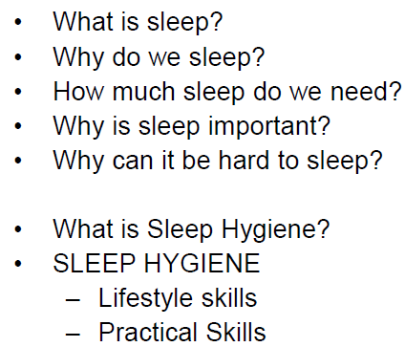

Slide 4
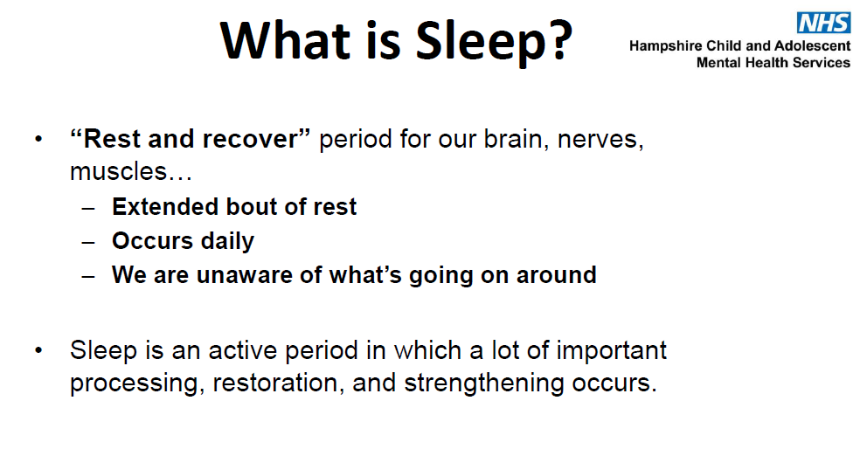

Slide 5
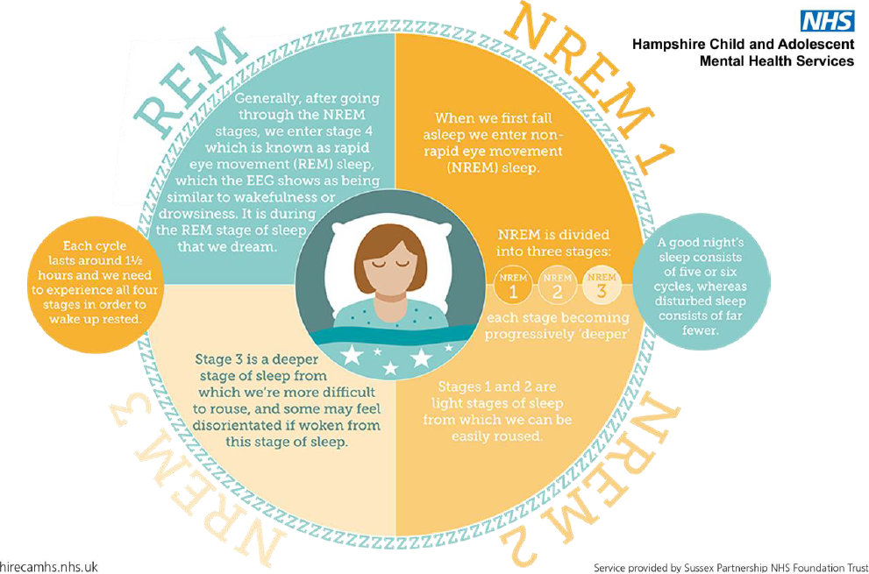
A good night’s sleep = 5 or 6 cycles
Each cycle lasts around 1.5 hours and we need to experience all four stages to wake up rested.
NREM – non rapid eye movement
3 stages – each becoming deeper
Stages 1 and 2 are light sleep – we can easily be roused at these stages
Stage 3 – much deeper sleep – we can be roused still, but might be disorientated if we are
REM – Rapid eye movement
We enter REM after NREM 1,2,3. This is the stage we dream in.

Slide 6
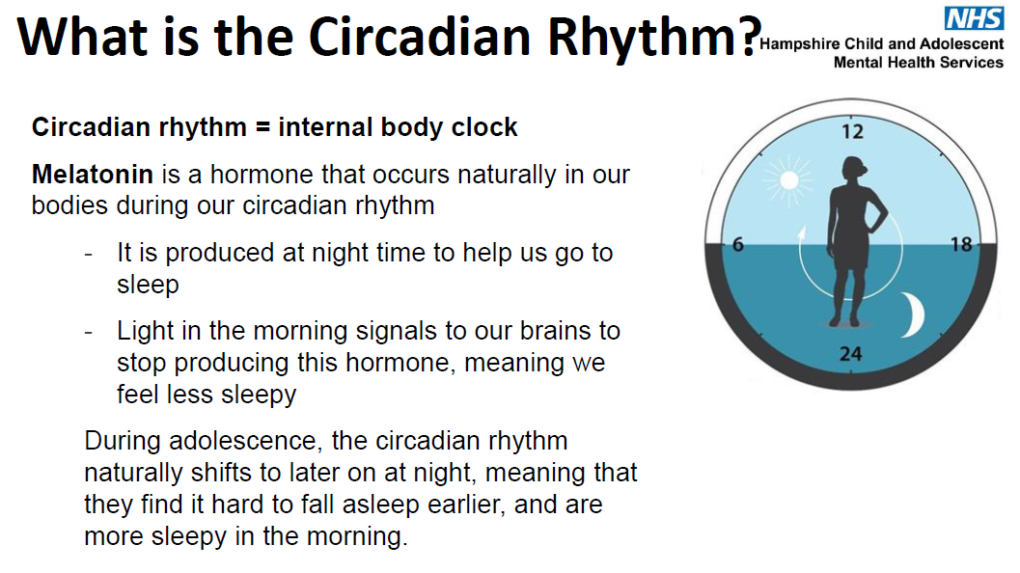

Slide 7
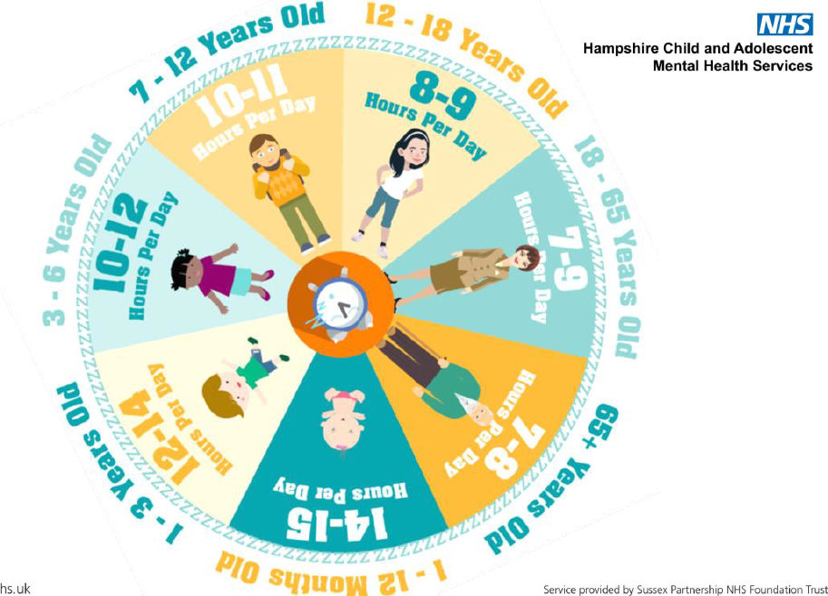
How much sleep do we need?

Slide 8

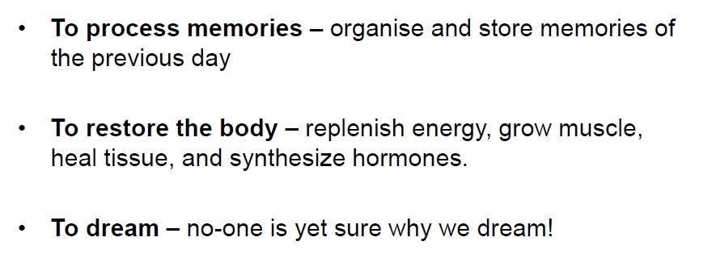

Slide 9
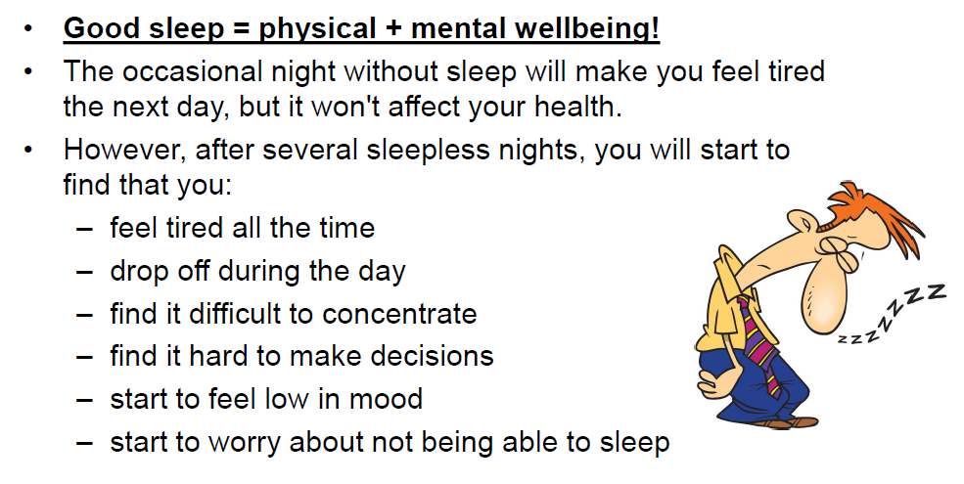
Why is sleep important?

Slide 10
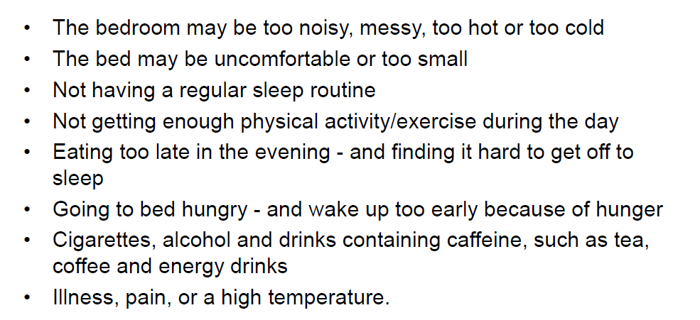
Why can it be hard to sleep?

Slide 11
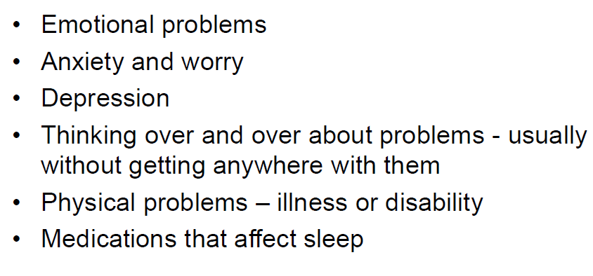
Long term reasons

Slide 12

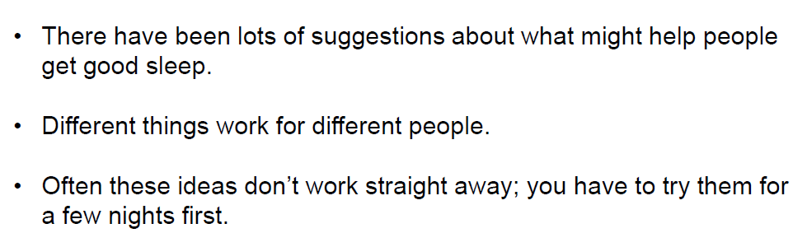
What is sleep hygiene?
'Sleep hygiene' refers to healthy habits, behaviours and environmental factors that can be adjusted to help you have a good night's sleep.
Poor sleep hygiene can negatively impact both sleep quantity and quality.

Slide 13


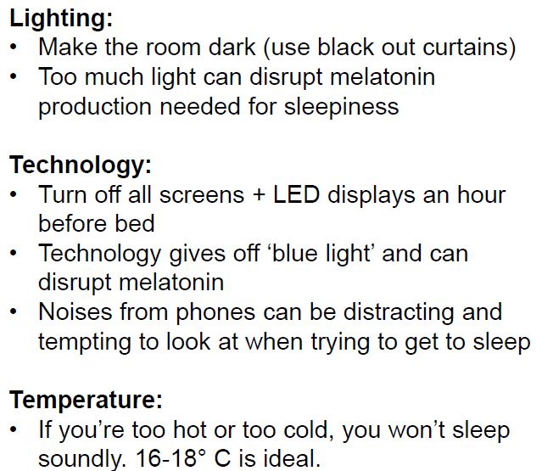

Slide 14
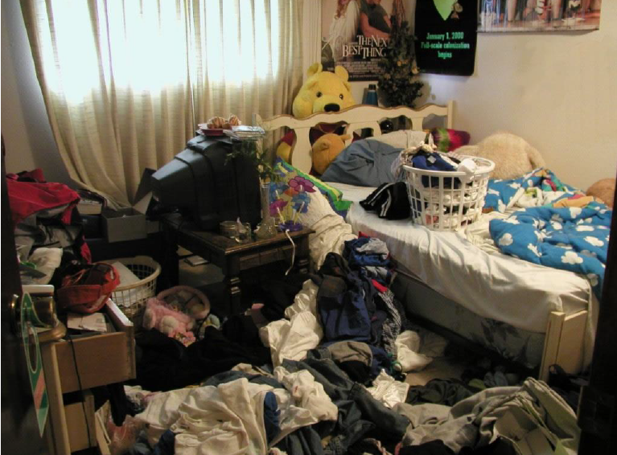
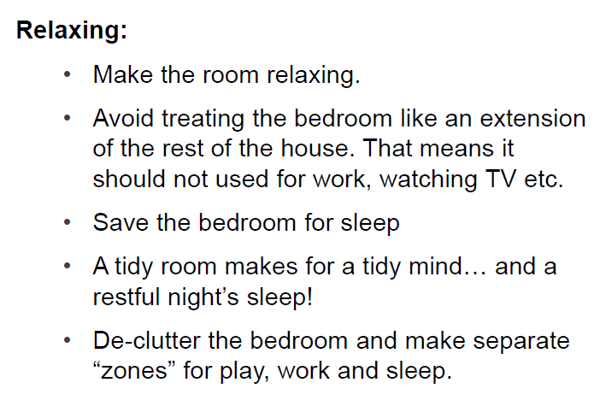

Slide 15
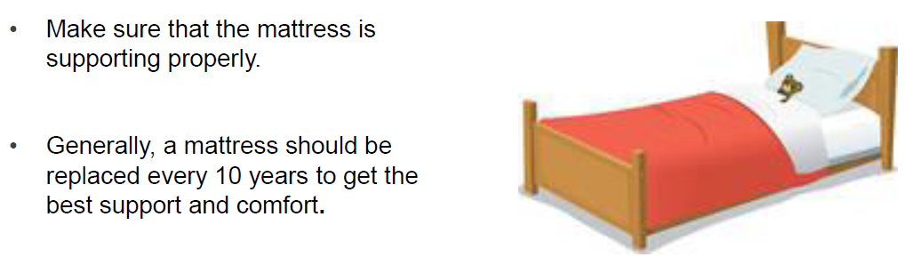
The Bed

Slide 16
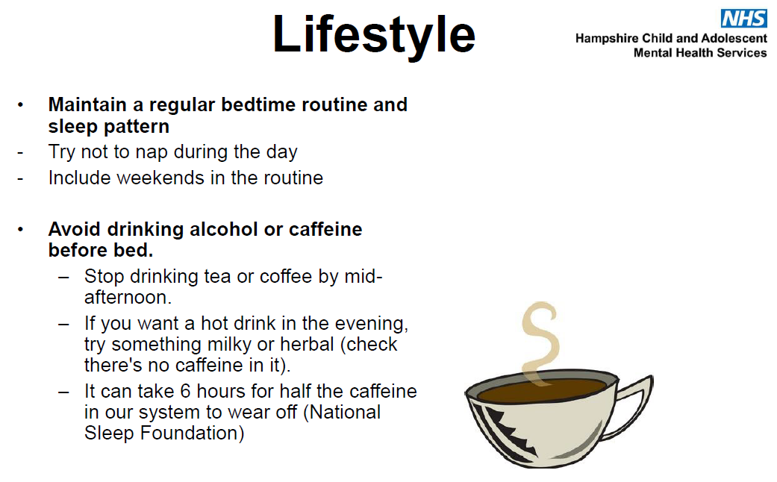

Slide 17
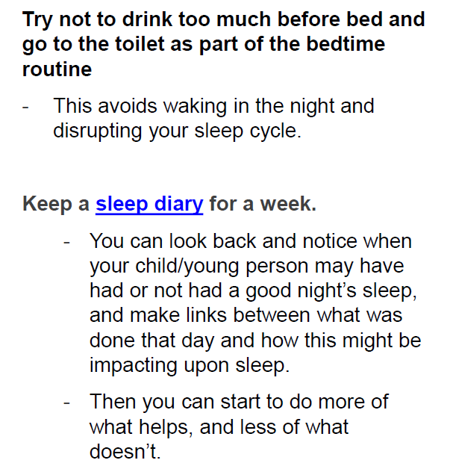
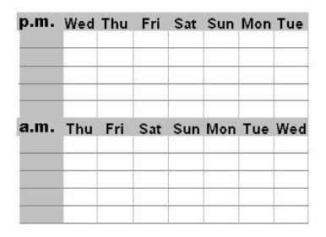
Track how your young person (and you) felt,
when they/you got more or less sleep too!

Slide 18
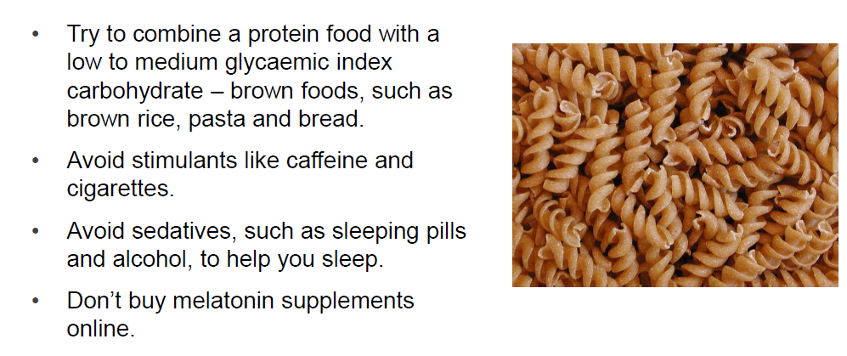
Diet

Slide 19
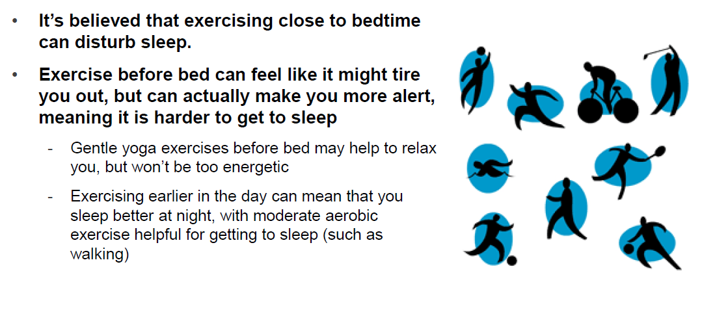
Exercise routine

Slide 20
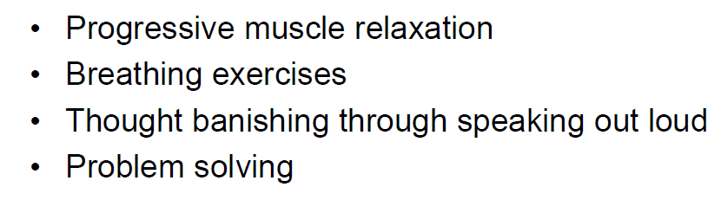
Soothing skills for in the moment

Slide 21
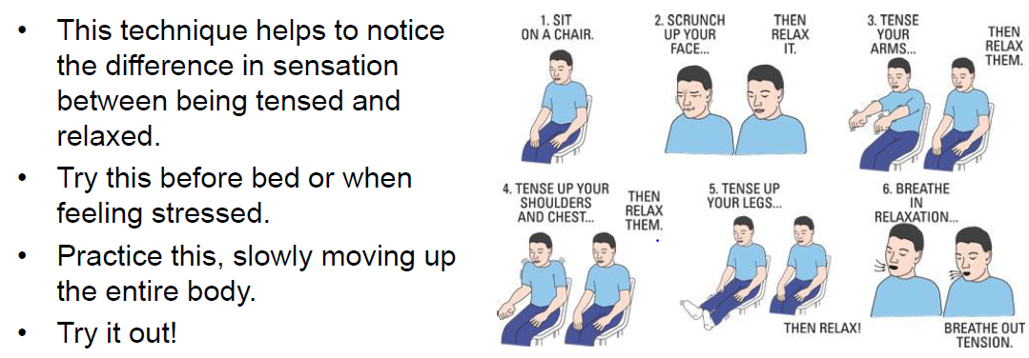
Progressive muscle relaxation

Slide 22
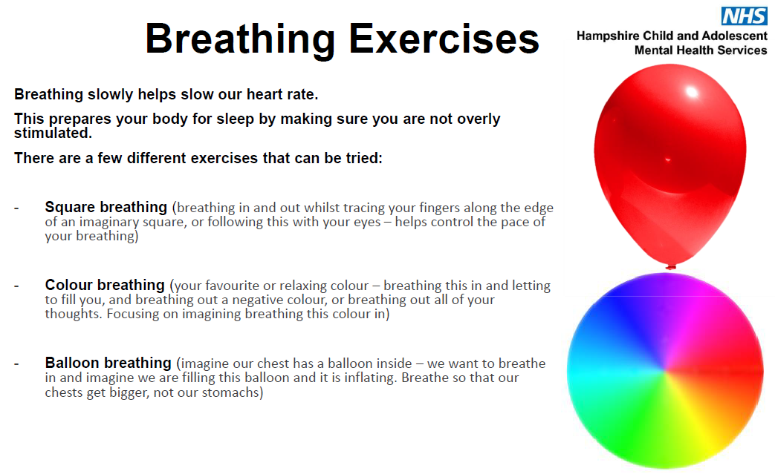

Slide 23
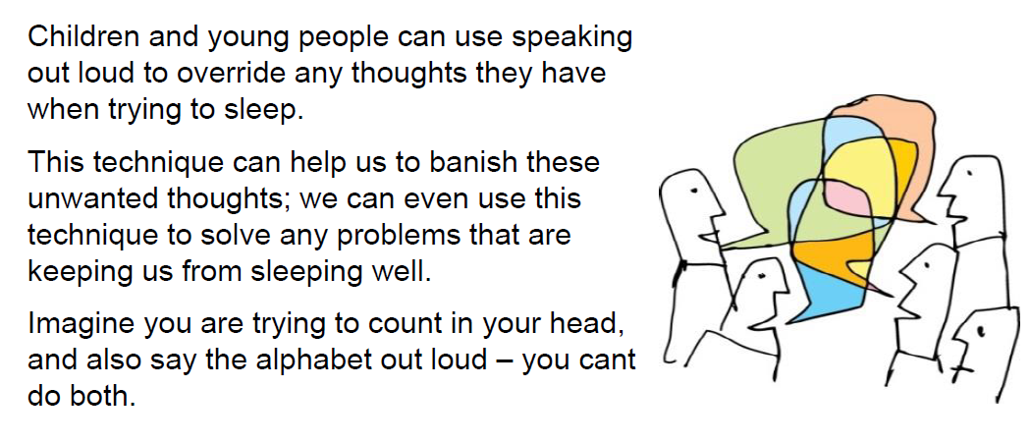
Speaking out load

Slide 24
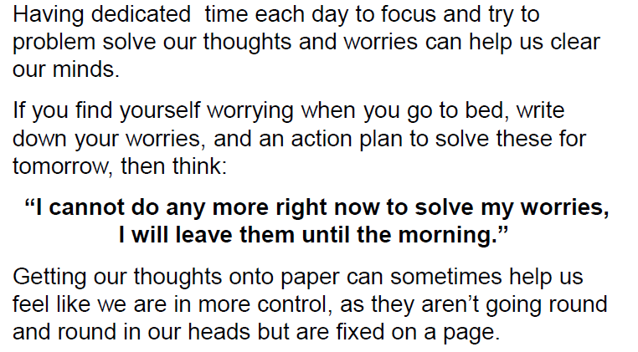
Worry time and problem solving

Slide 25
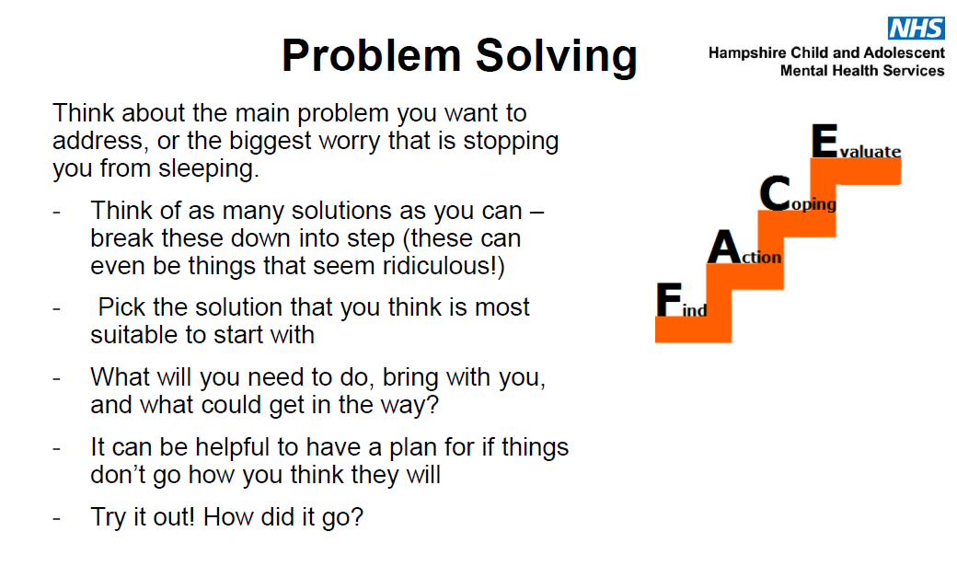

Slide 26
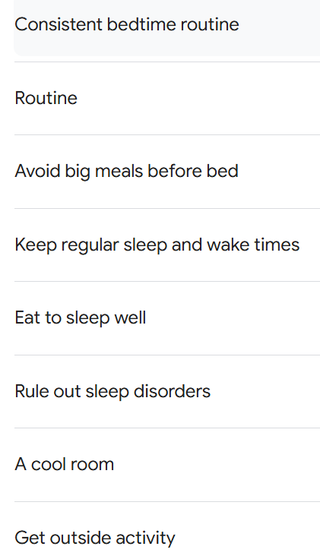
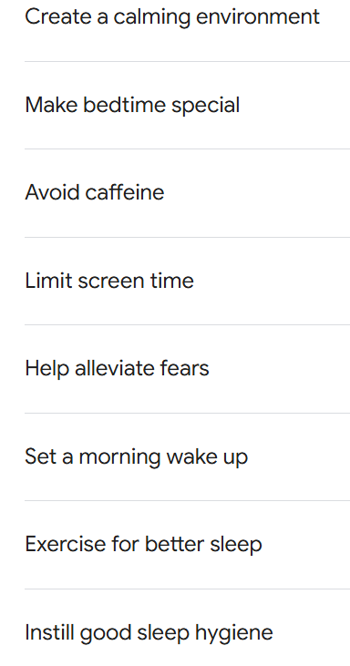
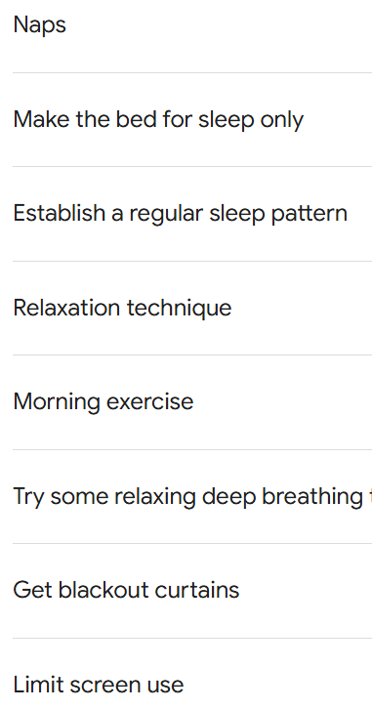
TOP TIPS!

Slide 27
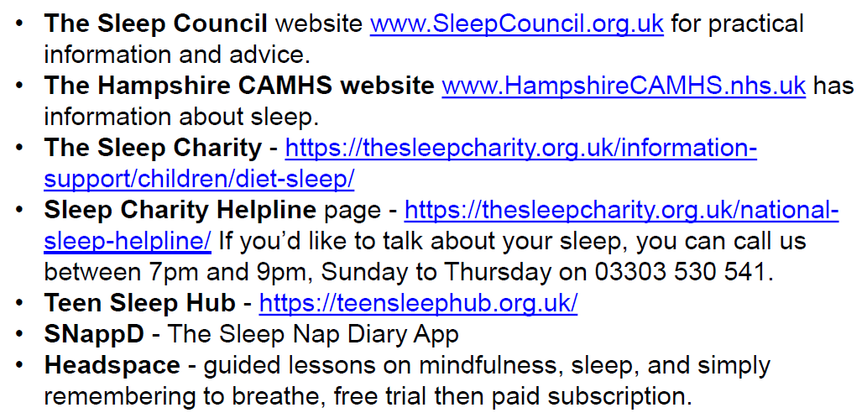
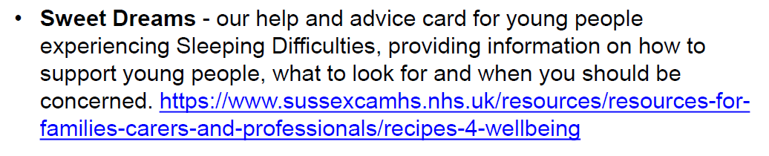
Helpful resources

