Slide 1

Cuppa and Chat
26th June 2024
Welcome!
Thank you for popping along today – it’s lovely to meet you! ☺
Please take a moment to sign in, grab a cuppa and snack…

Slide 2
Introductions….
House keeping….
What Cuppa and Chat is….
Plan for this session…..

Slide 3
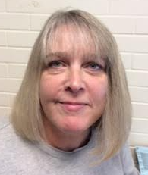
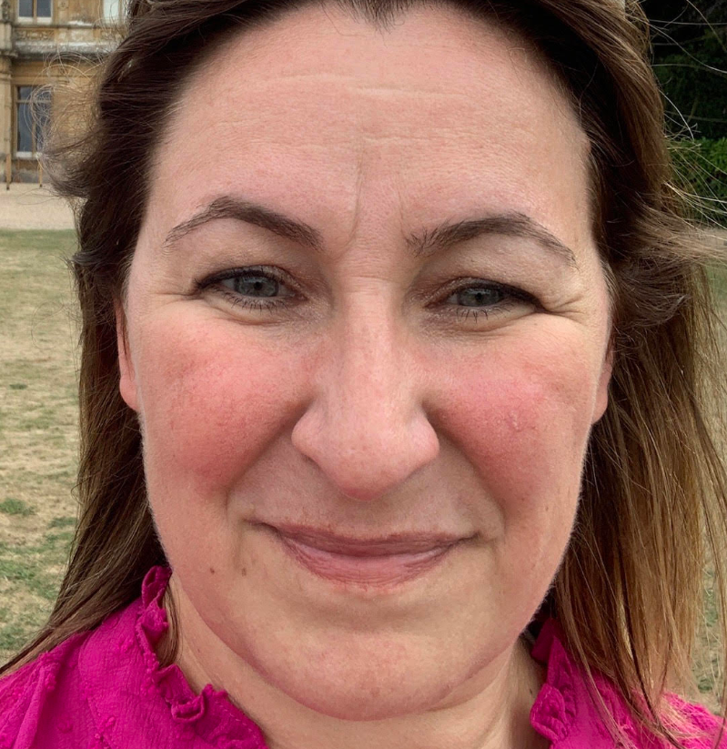
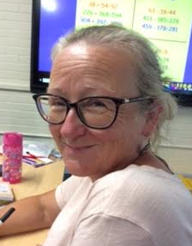
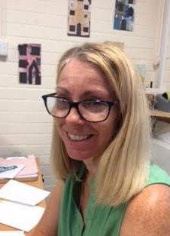
Mrs Allen
Mrs Llewellyn
Mrs Mort
Mrs Bishop
Our fabulous office team ☺

Slide 4

Our wonderful year 3 team ☺

Slide 5
Moving into year 3 at MJS….
You may already have a child/ren here…you (and your family) may be coming into MJS for the first time…you may be totally new to the area…you may have heard things / read things etc….you may be excited, worried, unsure what this next stage will mean, how you can help etc….we’re all coming from different starting points!
Firstly, please don’t be a stranger! We are a friendly staff who are committed to supporting your child in partnership with you. Every child is different – they all have different skills, qualities, needs etc and, together, we will do the very best we can to enable them to bloom over the next 4 years.
We understand that they are the most precious things in your lives. Please be assured that we all want the very best for them.
As such, it is important that we are a team. That we work together. Evidence has shown that those parents who engage with their children’s education, boost the outcomes. Think of it as a triangle:
Parents
‘Marchwood Family’…
Child/ren School

Slide 6

So what might this ‘engagement’ look like?
Regular reading (and signing study log)
Homework help
Times tables, numbers bonds
Asking questions about what they’ve done
Topical discussions
Thinking about out of school fun you can have to embed learning in school
We all love it when people are interested in our lives and our points of view.
Children are no different and love it when they know we are interested in what they’ve been up.
This gives value to what they are doing (because we place value on it too).
It facilitates opportunities for us to offer help.
It gives chances for us to say well done! Building self esteem and confidence is invaluable.

Slide 7
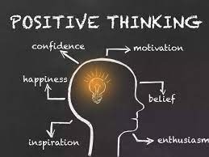
Moving into the next stage seamlessly….
Simple ways to help and support your child (we do this too! ☺):
Positive mindset…. ‘I know you’re going to have an amazing time…’ ‘I look forward to you telling me all about it later!’ ‘I will wave you off, then I need to go to work too! We can both talk about the best bits of our days tonight…’ ‘I wonder what you will learn about tomorrow?’
Be prepared…..develop independence eg ‘Is your uniform ready for tomorrow?’ ‘Have you popped your study log into you bag – remember you need it every day….’ (Make sure your part of the bargain has been done too! eg – study log is signed / forms have been completed etc ) Some children benefit from having a simple timetable stuck up somewhere at home with their clear jobs for the morning eg eat breakfast, get washed and dressed, brush teeth etc (this not only gives them responsibility and builds independence, but also can avoid the busy morning grumbles which can occur at home and can then make mornings harder for everyone…)
Building routines…children (and adults) do better generally if they know what’s going on/ what’s expected/ eat a balanced diet / get enough sleep/ exercise/ get outside etc!
Can your child do up their shoes? Get changed in and out of their uniform? Can they put their belongings back into their bag? Can they open up their lunch box etc….

Slide 8
Parents and carers can help by….
Labelling everything! Things do go missing, but we can normally match belongings up with children if they have a name and class in them ☺ Thank you!
Communication – Email: You can contact your child’s teacher via email. But please be mindful that their primary job is teaching the children in their care….
- Letters: Please read our communications with you – there are always key dates on there
- Office: email / phone/ pop in…..
- notice board
Following key procedures – eg go to class teacher first….call in for absences…
Positive goodbyes! A prompt goodbye with a big smile is invaluable – especially if your child is one who sometimes finds these transitions tricky….. Positive hellos! When your child comes out of school – remember to be present in the moment! Smile! Talk!
Keeping us up-to-date with contact information
Please don’t grumble online! If you are unhappy, concerned, have a question, PLEASE contact us. There may be a reason for something/ we may have done something wrong/ you may have heard the wrong thing etc ….but we cannot do anything, if you don’t let us know…

Slide 9
Our schools rules….
Ready…..respectful…..safe…..
Please help us by modelling our school rules too ☺
We promote ‘Marchwood Manners’ – we expect all of our staff and children to say please, thank you and be respectful to each other.
For the wider Marchwood Family to also promote these expectations would be wonderful!

Slide 10
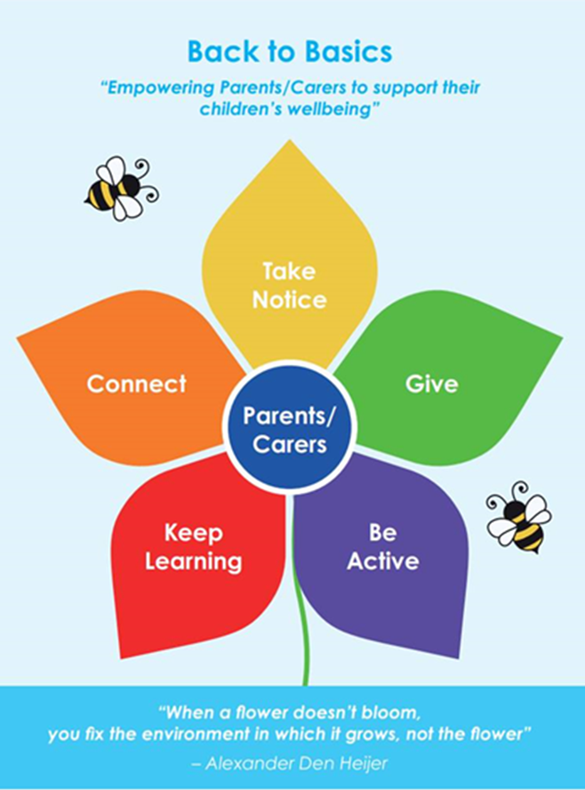
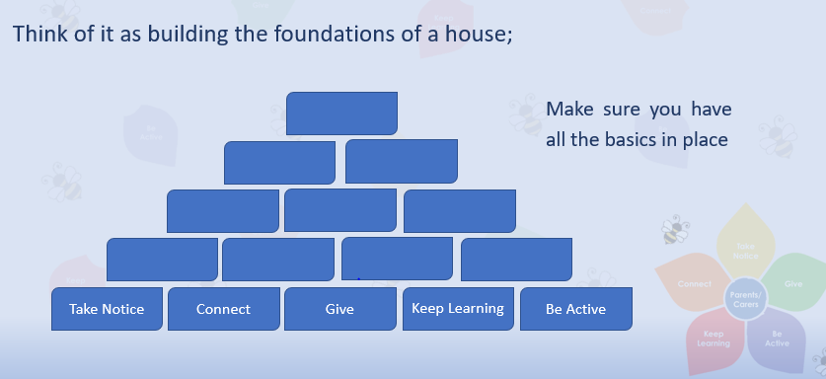
Initiatives….
Back to Basics is exactly what it says on the tin! It’s a Hampshire initiative and is being rolled out across schools and other support networks to support all families by encouraging a balanced life by following the principles of each petal….
We have been and will continue to develop this programme as a school over the next year, but perhaps it’s something your family could challenge themselves on over the holidays? Fun things to keep active, make connections etc

Slide 11
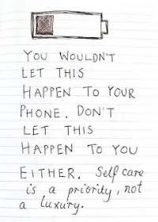
Self care….
Looking after yourself!!!
Remember….. You can’t pour from an empty cup….
Your mental health and well being is important too. (Those petals on the flower are for you too ☺ )
Parenting is hard!
We are not here to judge you, but we can offer help and support if you need it. If you feel that you need additional support please contact us and we can work together to determine next steps.
Eg a time to talk things through….FSW….MHST….SEND concerns etc

Slide 12
Summer challenges!
Can I quickly and quietly get changed into / out of my PE kit in 3 minutes?
Read about something you love….what can you tell me?
Connect with something/ someone new….what did you do? Who did you meet?
Be active – run around the garden/ outside space….stomp in the forest or at the beach….play a sport
Try something new….eg a nature hunt….painting a picture with
In fact, the children will be sent home with a summer challenge sheet – the top row is all about being ‘junior school ready’ and the rest is just a range of things they could do over the holidays ☺ (see next page)

Slide 13


