Slide 1

Marchwood Junior School
Parent/carer Workshop
‘Mindfulness’
Wednesday 2nd March 2022
Please help yourselves to refreshments ☺

Slide 2
Welcome!
You are very welcome today.
Thank you for joining us for our first session!
Introductions….
House keeping:
Refreshments
Fire
Sign out

Slide 3
Through sessions like these, we are aiming to offer support to families in regard to a range of topics.
We hope the session will be helpful to you. Please feel free to ask questions / share your own experiences / offer ideas too –we’re all in this together!
There are handouts of this presentation for you to take away with you. We will also make them available on our website.
Notes:
We aim for today to be informal – please feel free to ask questions or to share your own experiences.

Slide 4
So, what is mindfulness?
How can it help your children, you and your families?
Mindfulness is the basic human ability to be fully present, aware of where we are and what we’re doing, and not overly reactive or overwhelmed by what’s going on around us.
Mindfulness is a quality that every human being already possesses, it’s not something you have to conjure up, you just have to learn how to access it.
In theory, it’s simple isn’t it? Being present and focused in the moment. Except for the annoying fact that we so often veer from the matter in hand. Our mind takes flight, we lose touch with our body, and pretty soon we’re engrossed in obsessive thoughts about something that just happened or fretting about the future. And that makes us anxious.
We can use mindfulness to help to snap us back to where we are and what we’re doing and feeling.

Slide 5
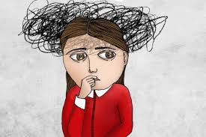
Take a moment to think about your life….all the things that may have happened in the course of half an hour this morning…the pet needed feeding, children needed breakfast, someone revealed they had homework to do that was due in today, you need to put the washing on, take something out of the freezer for dinner and this is before you’ve even thought about going to work!
Everyone’s situation will, of course, be different. But you get the idea – lots of plates spinning, being distracted from one situation to another, never actually finishing everything you started….it leads to fretful behaviour which leads to anxiety.
Yet it also all needs to be done doesn’t it?
However, if we are now in an anxious state about it all, this actually deters us from approaching each job in a focused manner, so things don’t get done and you feel more stressed out….

Slide 6
Let’s just remove ourselves from our situation for a moment and think about the young people in our lives.
What makes them veer away from the moment? Eg sat in a classroom….
A friendship issue
A family row
A worry about who is collecting them
Realisation that they forgot something
They’re not sure that they can do the work
Who they going to sit next to at lunchtime
What’s for dinner
Is the family pet okay?
The list goes on…..which means they’re not focusing on what they should be doing/potential tensions are increasing.
Yet, all of their concerns are valid. Little nuggets which are important to them. We need to help them almost partition them into priorities – and the priority at that moment was to do the work in class….

Slide 7
Having a scattered mind is OK. Our minds will wander, we will get distracted.
However, a scattered mind affects more than our concentration.
It can also affect how we are feeling.
The psychologists who discovered that we spend nearly half of our days daydreaming, found that when our minds are scattered, we are more likely to feel stressed, anxious, sad or angry.
This is because instead of experiencing our life as it is, we get caught up in thinking, worrying and being anxious about how things were or how they could be.
Through mindful meditation practices, we can train our mind to be more calm.

Slide 8
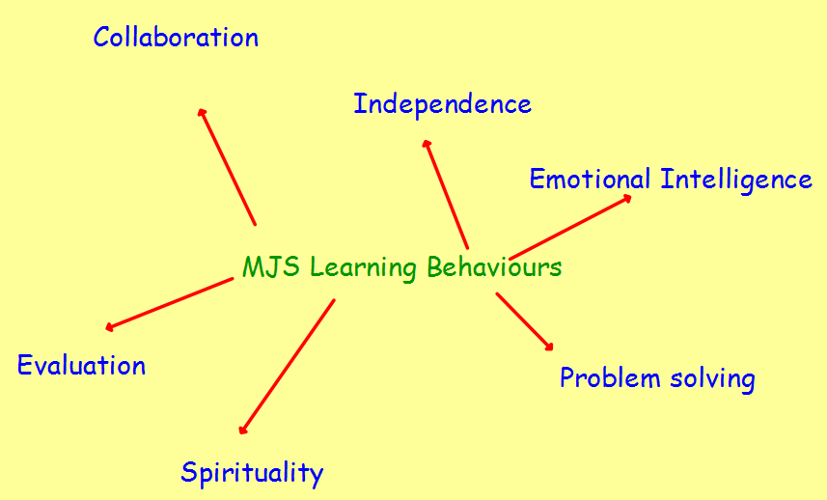
Our feelings and emotions are an integral part of mindfulness. All feelings are valid – there are no ‘good’ or ‘bad’ feelings. We just need to learn how to be in control of them.
At school we talk about ‘Learning Behaviours’. We discuss what they look like / why they make an impact / how we know we’re successfully applying a learning behaviour etc. Mindfulness ties in nicely with ‘Emotional Intelligence’.
Being aware of our own minds…
How do we feel about things?
How do we react to things?
What makes us tick or presses our buttons or calms us?
How do our emotions impact on others?
How do the emotions of others impact on us?
Once we are aware of our triggers and reactions we can start to implement strategies to help us control our emotions – not the emotions controlling us.

Slide 9
When your child (or you) start to feel that moment of being overwhelmed, of not being present in the moment, they (you) need strategies to hand which they (you) can implement and which will help to refocus and return them (you) to the moment.
So, we can use mindfulness and emotional intelligence to:
*Help us understand how we are feeling and how we can help ourselves be more settled and calm.
*Understand how we are feeling and how this can affect our behaviour. It can help us feel more calm and settled.
*Help us manage and live with our more difficult emotions such as: feeling stressed, feeling anxious, feeling sad, feeling angry
Mindfulness teaches us to be aware of, and understand our emotions.
By practicing mindfulness when we experience challenging emotions, it can help us to let them go.

Slide 10
Camhs (Child and Adolescent Mental Health Service) has a great website with lots of resources on – it is well worth a look.
Two ‘Mindfulness’ clips…. https://hampshirecamhs.nhs.uk/video/guided-mindfulness-leaves-on-a-steam/ https://hampshirecamhs.nhs.uk/video/2965/
Minfulness is a way to help you ‘unhook from thoughts which may keep you stuck in patterns of thinking…’
You need to initially recognise that you are the observer of your thoughts, not the thoughts themselves.
There are lots activities that you can try to help yourself become more mindful….

Slide 11
Here are some ideas which might be good for you and for your children!
Remember, mindfulness takes time to master! Keep practising and try different activities to find the best ones for you and your family….

Slide 12
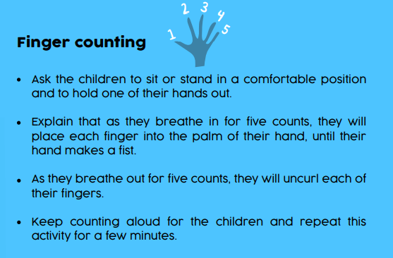
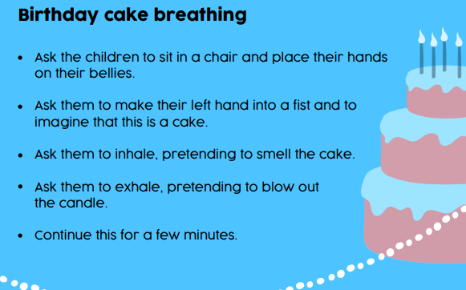
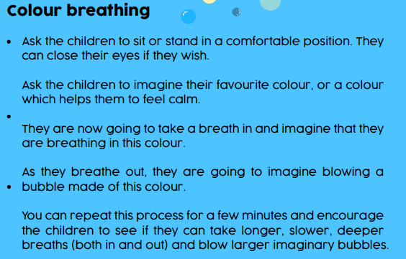
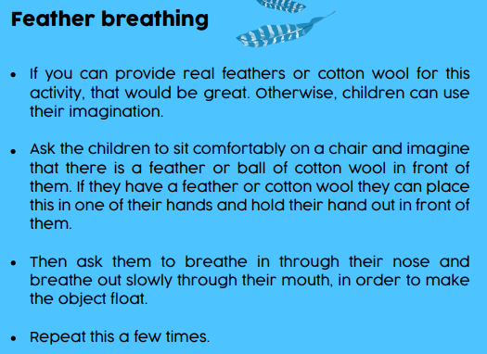
Breathing….

Slide 13
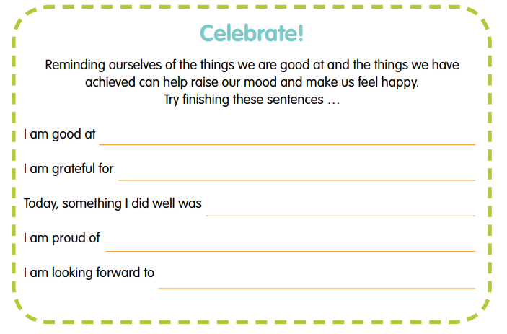
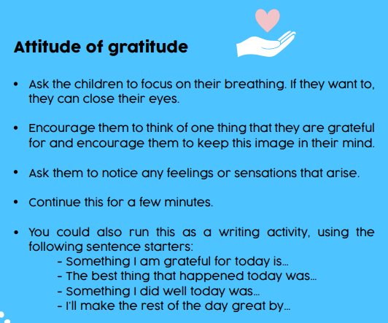
Well done!

Slide 14
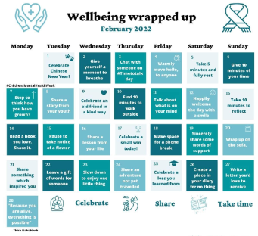
Plan in moments to be present in the moment…

Slide 15
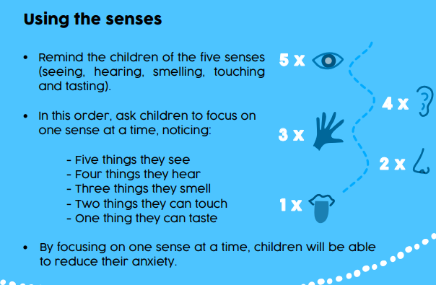
In touch with senses…..

Slide 16
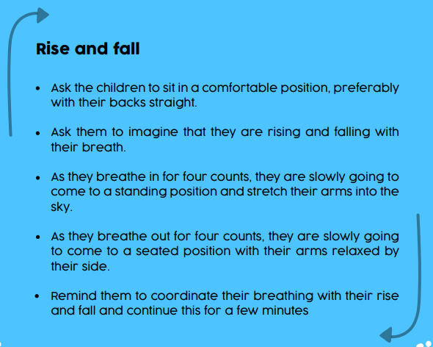
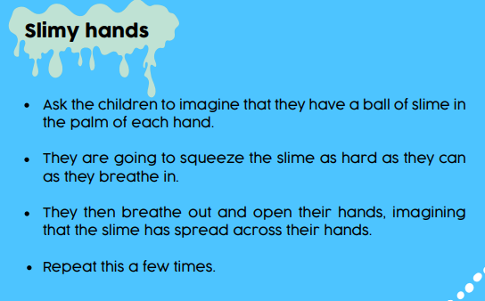
Physical and mental strategies…

Slide 17
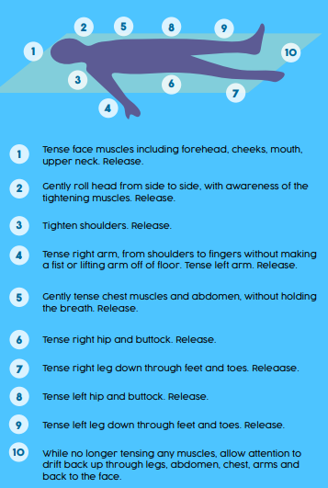
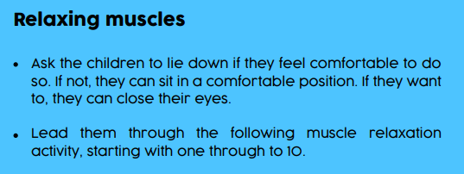

Slide 18
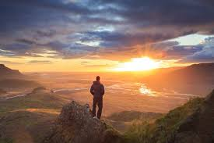

Search for different apps / clips to listen to or focus on to promote mindfulness….
Eg:
https://www.youtube.com/watch?v=ZToicYcHIOU

Slide 19
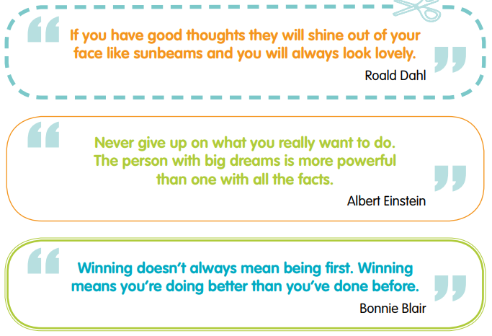
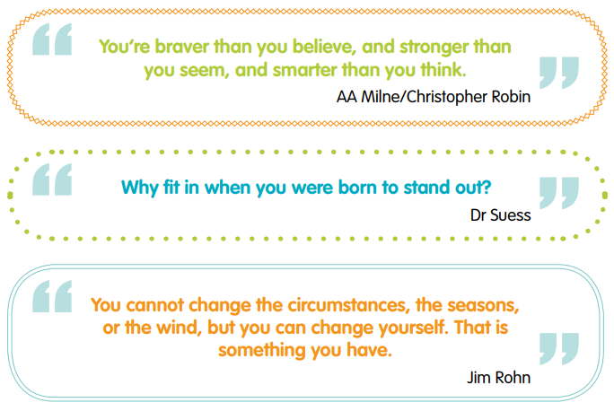
Positive affirmations/ thoughtful conversation starters….

Slide 20
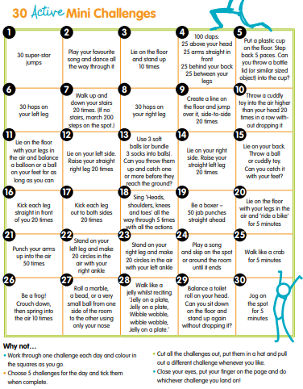

Slide 21
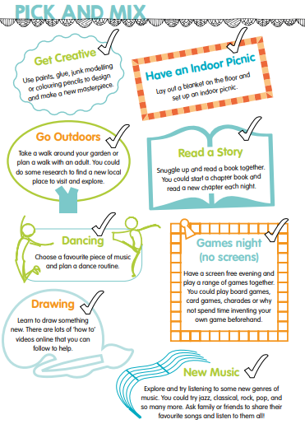
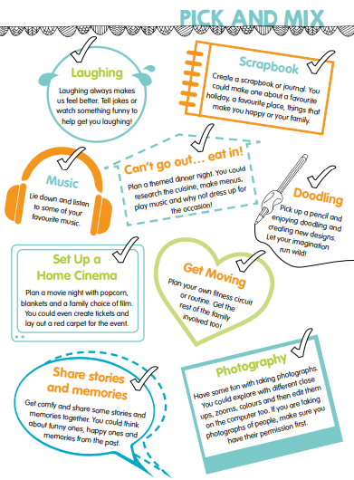
Family time….being present together in the moment….

Slide 22
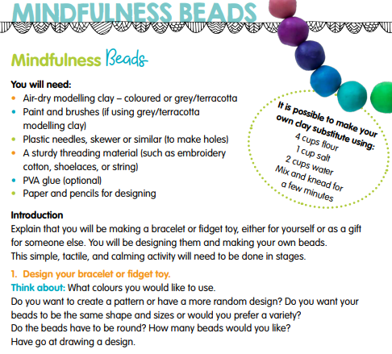
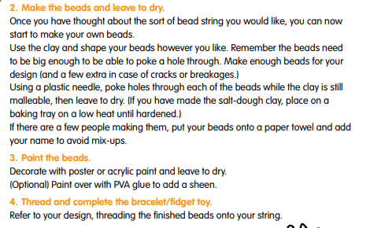
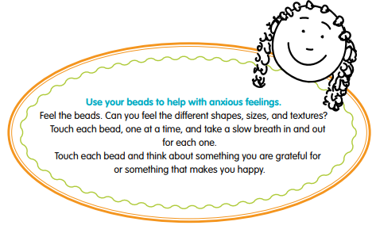

Slide 23
Types of mindfulness practice:
Mindfulness can be cultivated through proven techniques:
seated, walking, standing and moving meditation ( you can lay down – but this often leads to sleep!)
Short pauses we insert into everyday life
Merging mediation practice with other activities such as yoga or sports
Take your seat. Whatever you’re sitting on—a chair, a meditation cushion, a park bench—find a spot that gives you a stable, solid seat, not perching or hanging back.
Notice what your legs are doing. If on a cushion on the floor, cross your legs comfortably in front of you. (If you already do some kind of seated yoga posture, go ahead.) If on a chair, it’s good if the bottoms of your feet are touching the floor.
Straighten—but don’t stiffen— your upper body. The spine has natural curvature. Let it be there. Your head and shoulders can comfortably rest on top of your vertebrae.
Situate your upper arms parallel to your upper body. Then let your hands drop onto the tops of your legs. With your upper arms at your sides, your hands will land in the right spot. Too far forward will make you hunch. Too far back will make you stiff. You’re tuning the strings of your body—not too tight and not too loose.
Drop your chin a little and let your gaze fall gently downward. You may let your eyelids lower. If you feel the need, you may lower them completely, but it’s not necessary to close your eyes when meditating. You can simply let what appears before your eyes be there without focusing on it.
Be there for a few moments. Relax. Now get up and go about your day. And if the next thing on the agenda is doing some mindfulness practice by paying attention to your breath or the sensations in your body, you’ve started off on the right foot—and hands and arms and everything else.
Begin again. When your posture is established, feel your breath—or some say “follow” it—as it goes out and as it goes in. (Some versions of the practice put more emphasis on the outbreath, and for the inbreath you simply leave a spacious pause.) Inevitably, your attention will leave the breath and wander to other places. When you get around to noticing this—in a few seconds, a minute, five minutes—return your attention to the breath. Don’t bother judging yourself or obsessing over the content of the thoughts. Come back. You go away, you come back.
That’s it. That’s the practice. It’s often been said that it’s very simple, but it’s not necessarily easy. The work is to just keep doing it. Results will accrue.

Slide 24
Top tips:
Take some time out as a family….model mindfulness to your children….generate some ‘screen free time’ and give your family a new activity to engage in together!
Think about ‘Talk Time’…when does it fit in with you and your family? What might it look like?
New experiences to reconnect / recharge – especially after recent events

Slide 25
Key points to remember….
* Mindfulness helps to settle the mind.
* The mind is naturally scattered.
* Learning to focus the mind can help us to settle and feel calm.
* This can help us to better understand our feelings and emotions.
* It can help us to not get so distracted by our thoughts.
* Practicing mindfulness can have a positive impact on how we feel and on our mental health.
Thoughts? Questions? How could you apply this to you and your family?

