Slide 1

Marchwood Junior School
Parent/carer Workshop
‘Emotion regulation’
Thursday 23rd November 2023
Please help yourselves to refreshments ☺

Slide 2
Welcome!
You are very welcome today – thank you for joining us!
Please make sure you have signed in on the sheet – thank you
Introductions….
House keeping:
Refreshments
Fire

Slide 3
Through sessions like these, we are aiming to offer support to families in regard to a range of topics.
We hope the session will be helpful to you. Please feel free to ask questions / share your own experiences / offer ideas too –we’re all in this together!
There are handouts of this presentation for you to take away with you. We will also make them available on our website.
Today our focus is on emotional regulation – learning how to support our young people when they express their emotions in a heightened state.
However, to begin with we’re going to look at preventative measures we can take so that the extremes of behaviour are less likely to be seen.
Notes:
We aim for today to be informal – please feel free to ask questions or to share your own experiences.

Slide 4
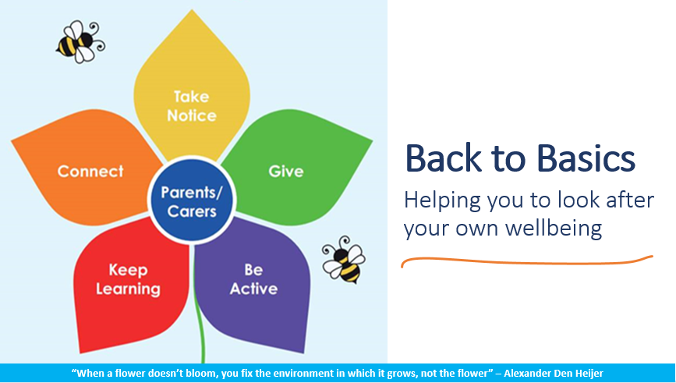

Slide 5
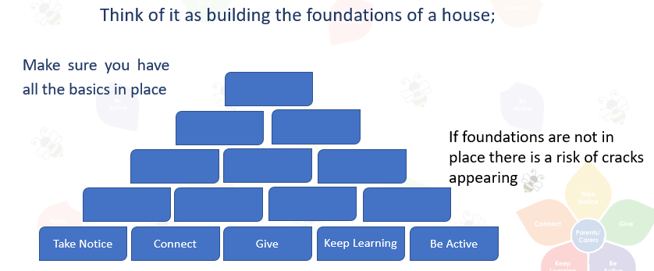

Slide 6
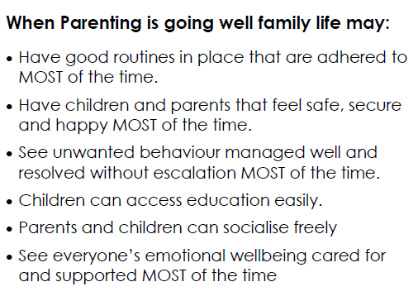
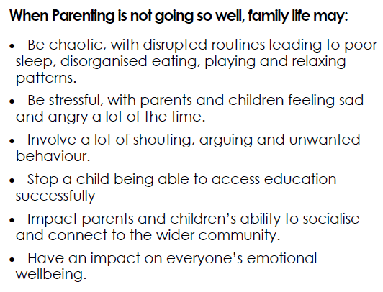
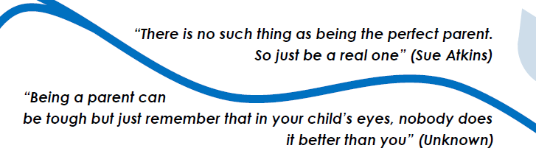

Slide 7
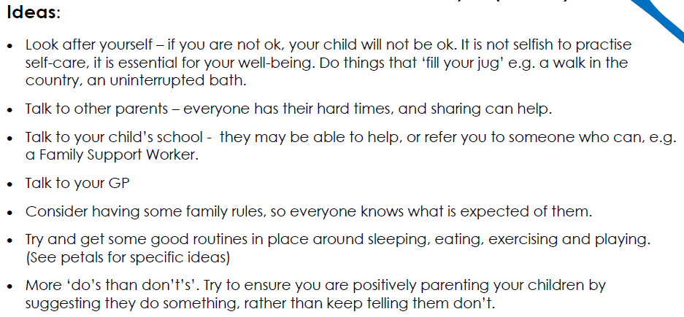

Slide 8
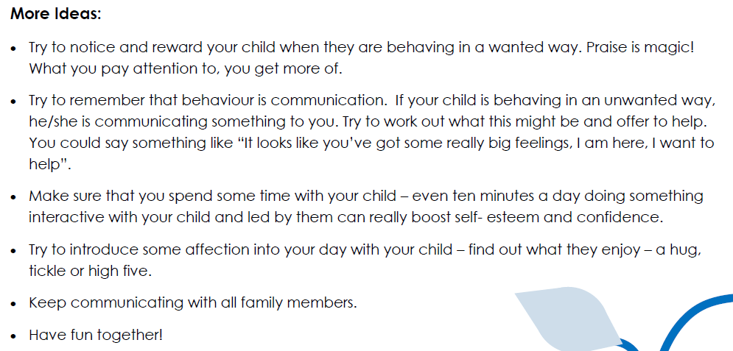

Slide 9
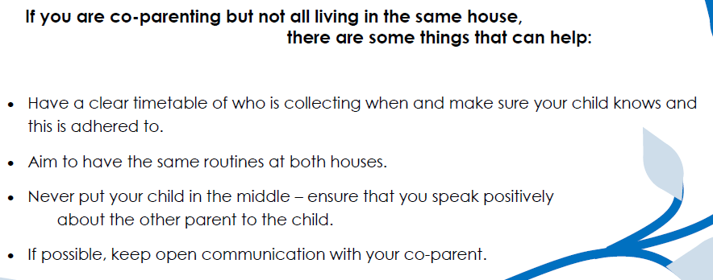
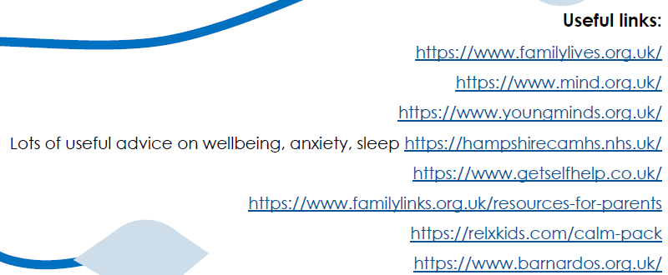

Slide 10
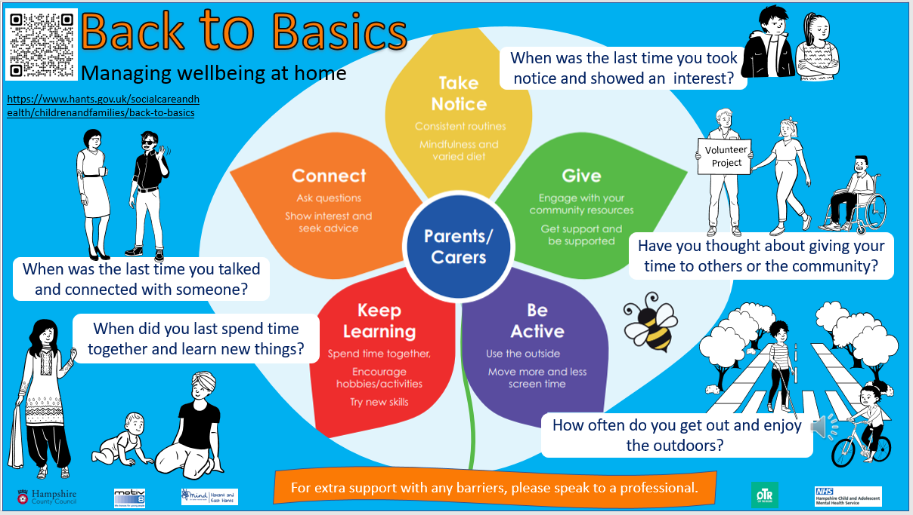

Slide 11
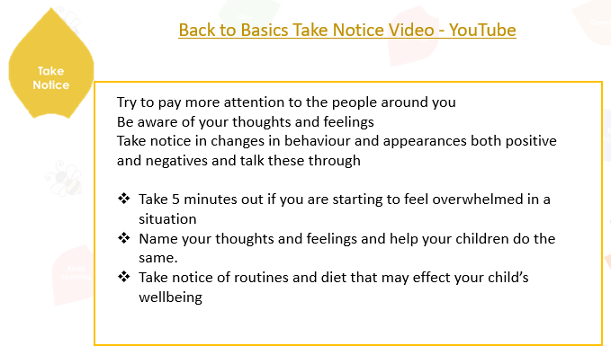
Back to Basics Take Notice Video - YouTube
Look what you can see out of your window and how it changes
Paint or draw a picture
Think about how you are feeling today
Listen to the sounds of nature like the wind and the rain
Play I spy
Notice how your friends and family are feeling today
Practice the 5 senses to calm down – something you can see, hear, smell taste and touch.

Slide 12
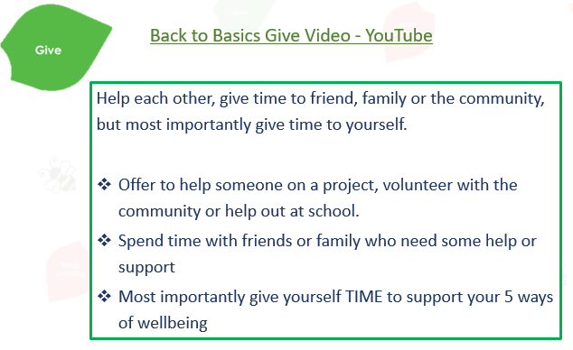
Back to Basics Give Video - YouTube
Smile and say thank you
Make a homemade present or card for no reason
Hold the door open for someone
Give someone you love a hug
Send your old toys to the charity shop
Share your time with each other
Help around the house – wash the dishes or do some dusting
Listen to someone else and how they are feeling

Slide 13
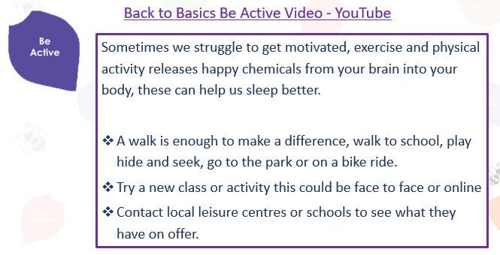
Dance to your favourite song
Walk the dog
Hula hoop
Join a sports team
Play a game in the playground
Walk or cycle to school
Help in the garden
Run a race with a friend
Make up your own sports.
Back to Basics Be Active Video - YouTube

Slide 14
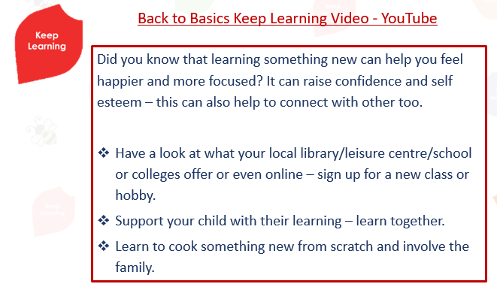
Learn a new word each day
Visit a museum or art gallery
Try out a musical instrument
Do a word search
Try a new food
Learn to cook a new recipe
Study an animal or bug
Visit a new place
Write a story, song or poem.
Back to Basics Keep Learning Video - YouTube

Slide 15
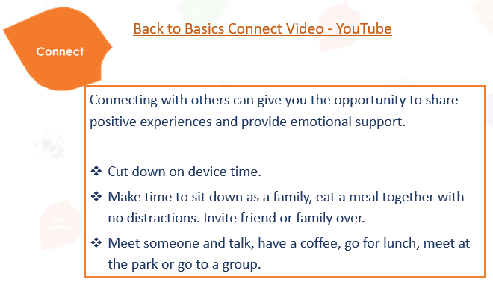
Talk to your friends and family
Help a friend or neighbour
Eat a meal with you family
Say hello
Bake some cakes and share
Back to Basics Connect Video - YouTube

Slide 16
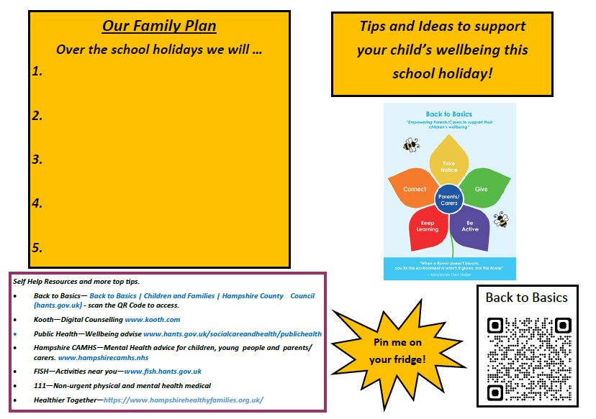

Slide 17
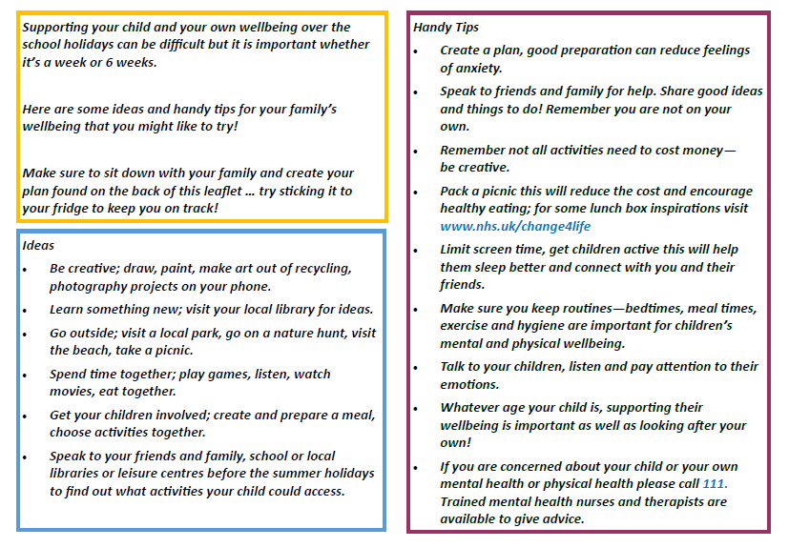

Slide 18
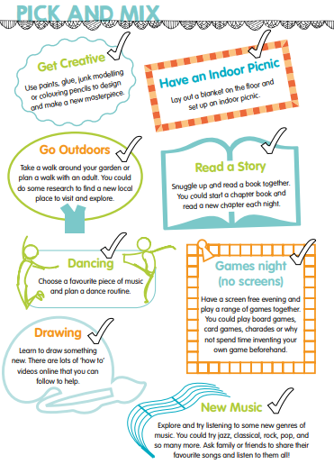
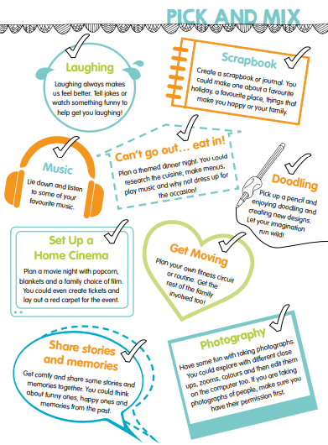
Family time….being present together in the moment….

Slide 19
Let’s move on to thinking about the reactions of our children in different situations and how we can support them in order for them to learn how to calm and self calm (regulate) moving forwards….
How might our children behave / respond?

Slide 20
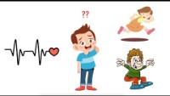
Why might this happen?
Think of a cave man….there’s a rustling in the bushes….what might it be?
His body’s focus is staying alive. As such, it jumps into ‘Fight’ (face it), ‘Flight’ (run) or ‘Freeze’ (stay and hide) response mode.
So the reactions of our bodies are its way of engaging survival mode ‘FFF’.
Blood gets sent to the arms and legs (the energy goes there so that we can run) but this can make us feel sick… or our extremities tingle…it can make us tired…
Our brain is excellent at keeping us alive in dangerous situations, but now-a-days we don’t have those dangers….but our bodies still revert to FFF in error.
The brain mistakes something as a danger, so we need to tell our brain
to calm…
All of us can learn strategies to help us do this. The more we do it, the
more it becomes embedded in our tool kit and becomes instinctive.

Slide 21
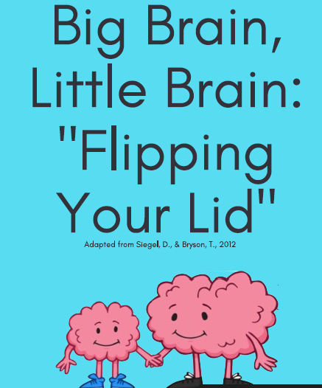
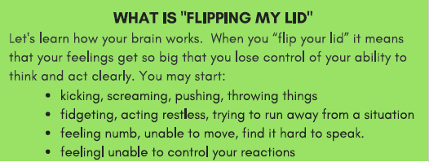

Slide 22
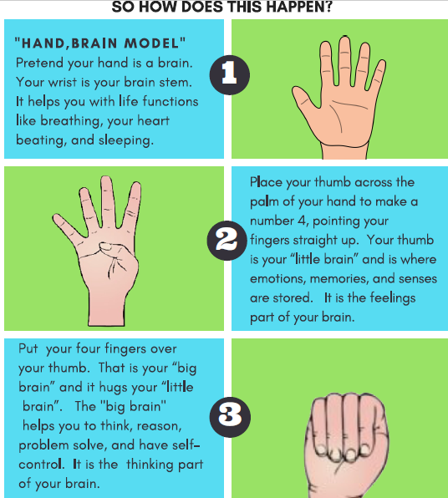

Slide 23
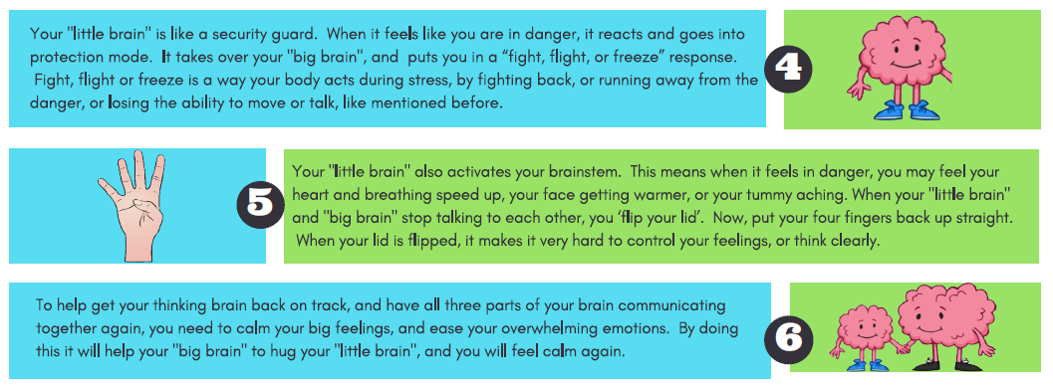

Slide 24
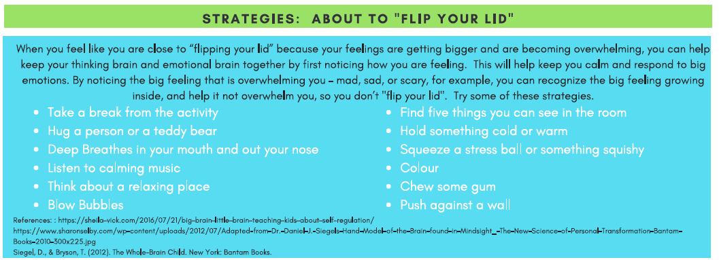

Slide 25
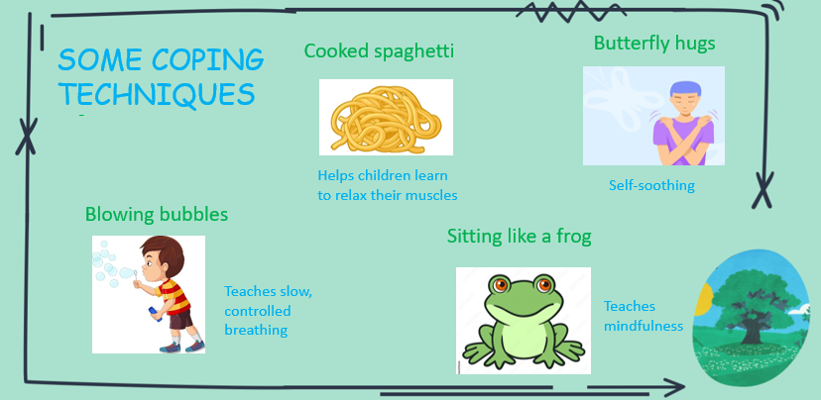
Coping and Resilience Programme (CARE)
If you can relax your mind, your body will follow

Slide 26
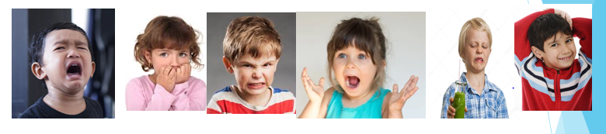
The tricky bit is in the moment when our young people are feeling and reacting to a big emotion….
The emotions:
Distress/sadness Fear Anger Surprise Disgust Joy/Happiness
6 Emotions that are observed across cultures and countries
Our emotions are natural, normal and hardwired for our survival

Slide 27
We can respond in different ways to the emotions on show:
Emotion Coaching
Emotion Dismissing
Emotion Disapproving
Laissez-faire/Permissive

Slide 28
Emotion disapproval
Disapproves of negative emotions as a sign of weakness, lack of control, unconstructive.
Lacks empathy, noticeably critical and intolerant.
Tries to get rid of negative emotions via discipline, reprimand, punishment.
Focuses on the behaviour rather than the emotions generating the behaviour.
More likely to view negative emotional displays as a form of manipulation, lack of obedience, sign of bad character.
Often motivated by need to control and regain power and/or to ‘toughen up’ child.

Slide 29
Emotion dismissing
Despite good intentions (wants to make child feel better) is uncomfortable, fearful, anxious, hurt, annoyed or overwhelmed with negative emotions
Wants negative emotions to go away quickly
Considers paying attention to such emotions will make them worse, prolong them
Tries to stop negative emotions by reducing/minimising/making light of their importance/significance, e.g. it’s no big deal, don’t worry about it, be a big girl, that’s like, you’ll be fine
Often motivated by need to rescue and make things better, fix the problem, e.g. have a biscuit, I’ll buy a new one, you need to do this.
Focuses on getting rid of the emotion with logic or distraction rather than understanding the feelings.

Slide 30
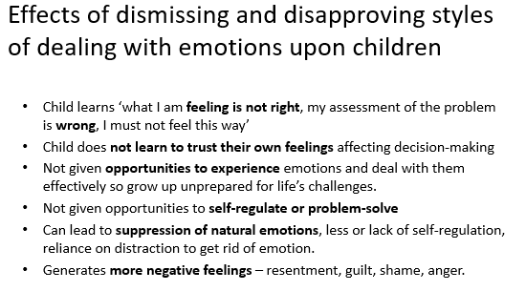

Slide 31
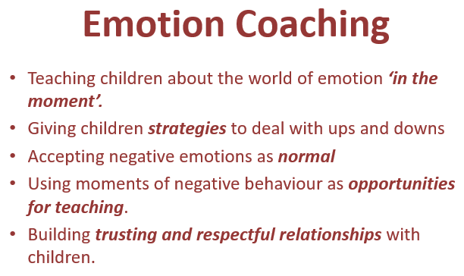

Slide 32
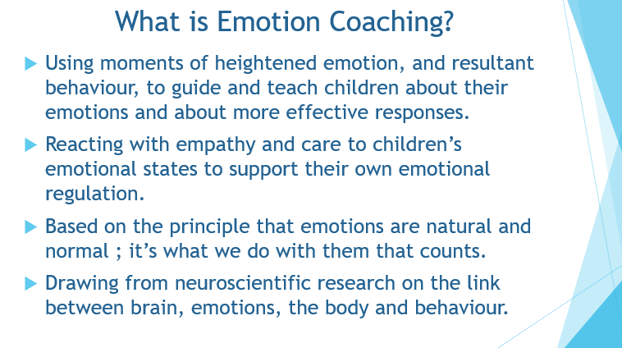

Slide 33
Why Use Emotion Coaching?
Gottman (1997) found that Emotion coached children could:
Regulate their own emotional states
Be better at soothing themselves when upset
Calm down their hearts faster
Had fewer infections and illness
Be better at focusing attention
Relate better to other people (even in challenging social situations, for example being teased)
Were less prone to acts of violence
Be better at understanding people, forming relationships and …
Greater academic performance

Slide 34
The 4 steps of Emotion Coaching
Step 1
Recognising the child’s feelings and empathising with them
Step 2
Validating the feelings and labelling them
Step 3
Setting limits on behaviour (if needed and appropriate) and co-regulating
Step 4
Problem-solving with the child

Slide 35
Emotion Coaching | Chimp Management
Recognise (Name it to tame it) | Recognise your chimp
Validate | Exercise your chimp
Set limits and co-regulate | Distract your Chimp
Problem solve | Create auto pilots

Slide 36
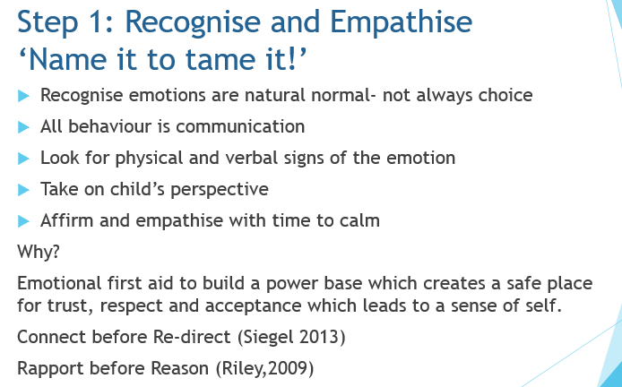

Slide 37
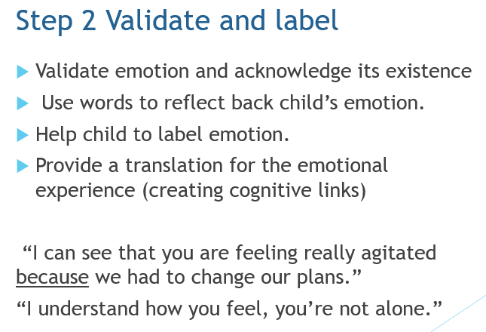

Slide 38
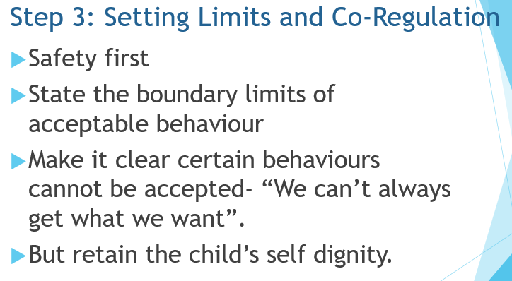

Slide 39
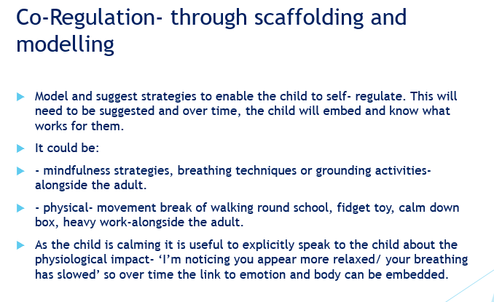

Slide 40
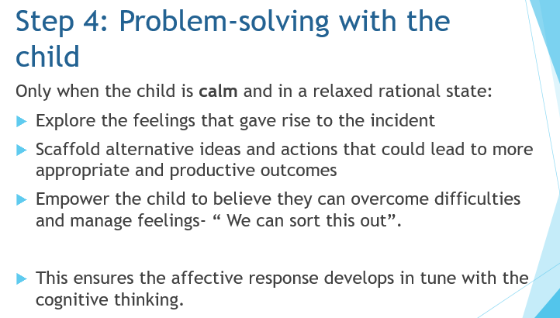

Slide 41
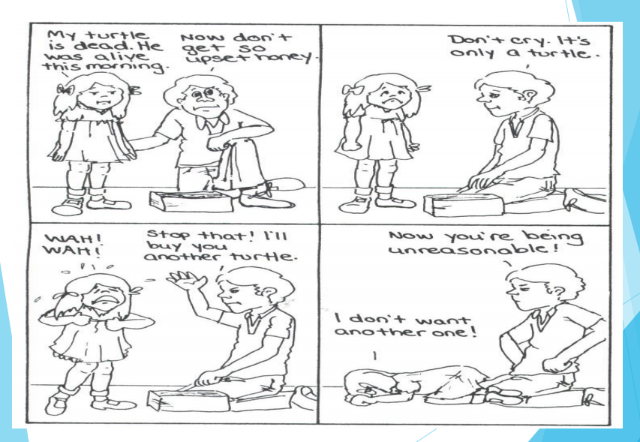
Instead of denying the feeling…

Slide 42
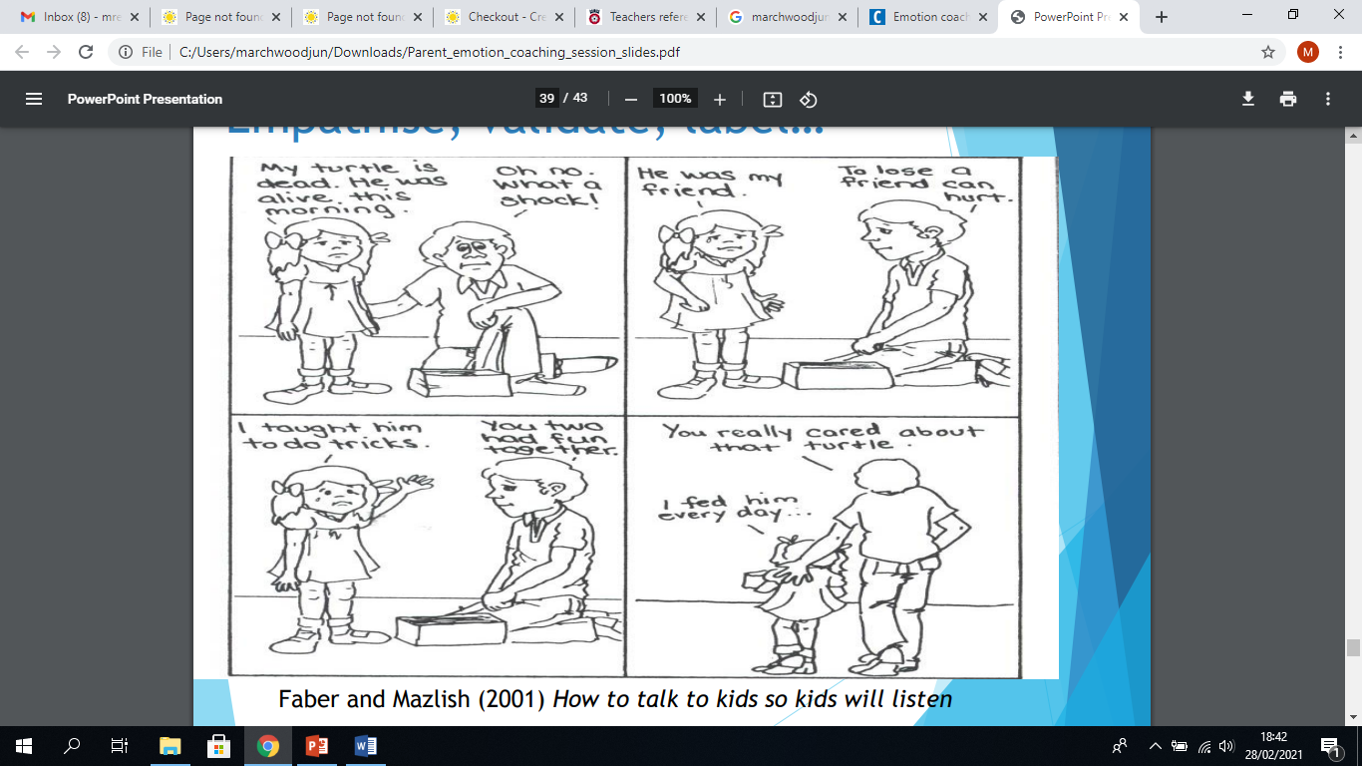
Empathise, validate, label…

Slide 43
It’s not all about strategies …
Your relationship will always be the greatest intervention
Every interaction is an intervention
Connect before you correct

Slide 44
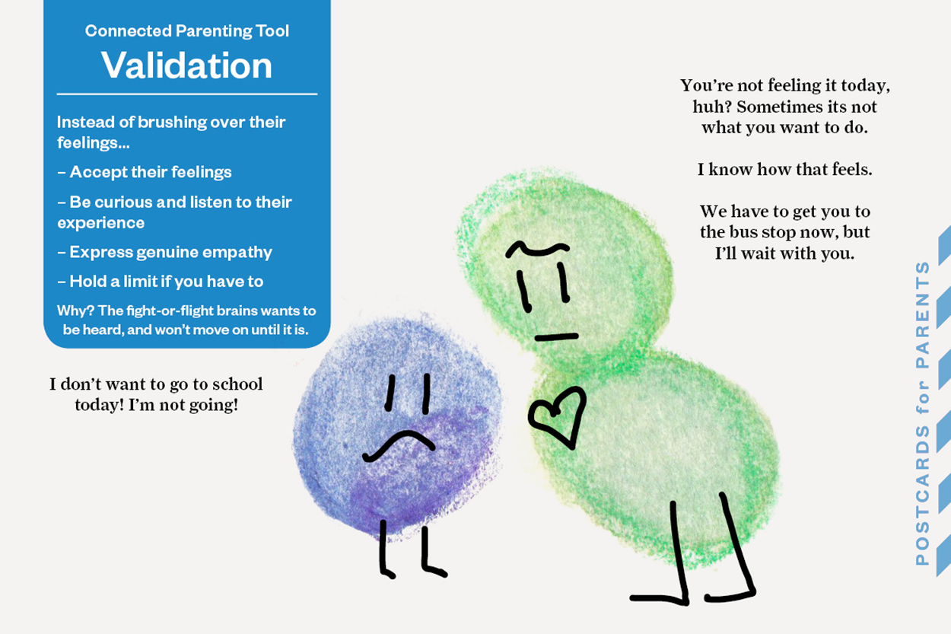
How do we validate this feeling?
Notes:
The fight-flight brain wants to be heard and won’t move on until it is!

Slide 45
Notes:
The fight-flight brain wants to be heard and won’t move on until it is!

Slide 46
When children want something they can’t have, adults usually respond with logical explanations of why they can’t have it.
Often, the harder we explain, the harder they protest.

Slide 47
Sometimes, just having someone understand how much you want something makes reality easier to bear.
From How to Talk So Kids Will Listen and Listen So Kids Will Talk by Faber and Mazlish
Notes:
Nothing has changed about the situation, but how you have chosen to approach it, has made all the difference

Slide 48
Scenario - Jimmy becomes upset that he has to stop something he is enjoying.
Acknowledge the feeling and validate
e.g. “This feels so disappointing, you really wanted to carry on playing didn’t you. I don’t like stopping fun things either”
Hold the boundary
“It is time to tidy away now. Just ask me if you’d like some help”
Problem solve/Offer help
“Use your words to ask me and I can you help tidy”
If not responding, adult could offer “If you’d like some time, we can use the safe space first”.

Slide 49
Some examples …
“ Wow, so much energy today. It can be hard to focus when you feel excited”
“Oh Frank, you’re right, work can sometimes feel boring and it’s really tough when we feel like that”
“It feels really difficult to share me today”
“It can feel really hard to have to wait for my attention”
“It must feel really annoying when you feel adults are always telling you what to do”

Slide 50
“Oh my goodness, this feels really frustrating!”
“That must have felt so frustrating to have to stop when you were having fun”
“It’s really hard to concentrate when you are worried about Dad”
“You really wanted to have the toy to yourself, didn’t you? Sometimes it feels really hard to share”
“You find it really hard to believe you can do this on your own”

Slide 51
Blame yourself
“Oh silly me, I don’t think I have explained that very well”
“Sorry, that’s my fault, I forgot to ask you to walk”
Said with a warm smile
“I must be imagining things, Frank is not in his seat?!”
Prepare for the upcoming instruction
“Right, I’m going to do my bossy teacher bit, and I’m about to ask you to do something …”
Use a playful approach …

Slide 52
Speak to the feeling first BEFORE holding the limit/problem solving
“Look how much energy you’ve got today Sally. Let’s pop the stick down and remember to give space, so we can play safely”
“Oh Frank, you look so fed up. I wonder if you’re worried about your dentist appointment. I’m here if you want to talk or you can use the safe space”
“Oh Geoffrey, look how upset you are. You look really angry. Let’s pop to the chair and I’ll see how I can help you”

Slide 53
Other scripts
Just ask me first
“I’m sure you can do x, but just ask me first”
What am I going to say?
“Frank, what am I going to say?” [said in a playful tone of voice]

Slide 54
Invitation or a demand?
Children often respond to an invitation more than a demand, so
“I wonder if some time with your stress ball/slime will help”
“The quiet room is available”
“Let me know if I can help you”

Slide 55
Get down to the child’s level
Check your proximity
Appropriate touch
Open, relaxed body language
Facial expression
Soft, relaxed eye contact
Check your non-verbal cues

Slide 56
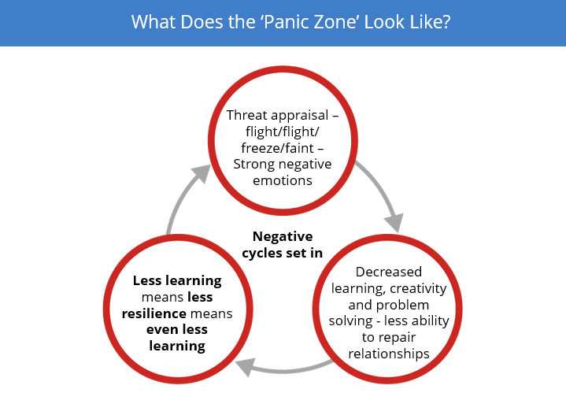
So, if our brains flood with FFF responses it can look like this:
By being supported in recognising our emotions, we can then identify what we can do to help us calm or react differently in the future. In turn this helps us to become more resilient and control the limbic regions of our brain (our ‘little brain’).

Slide 57
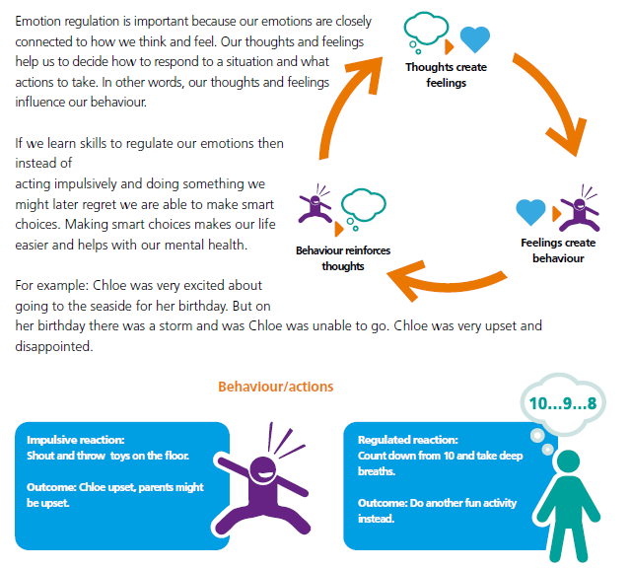

Slide 58
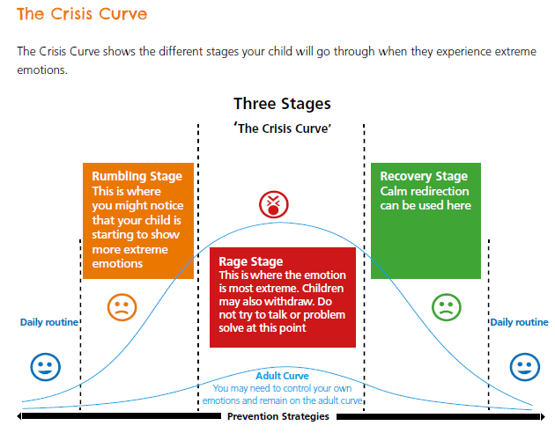

Slide 59


