Slide 1
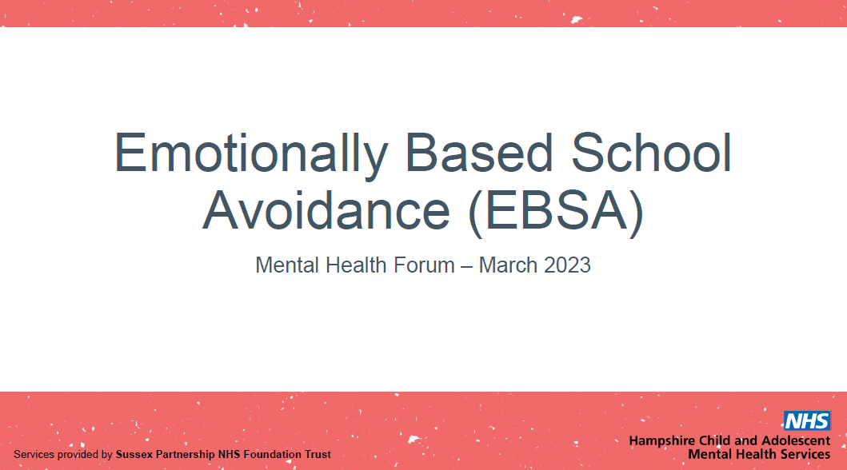

Slide 2
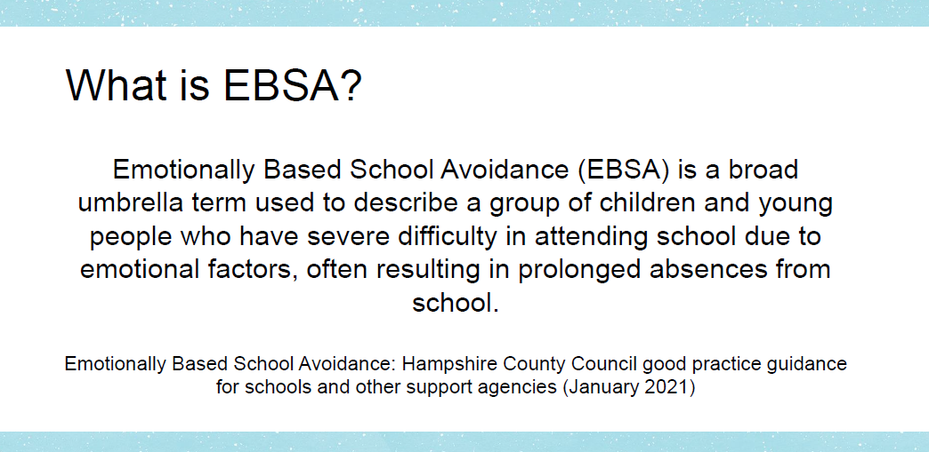

Slide 3
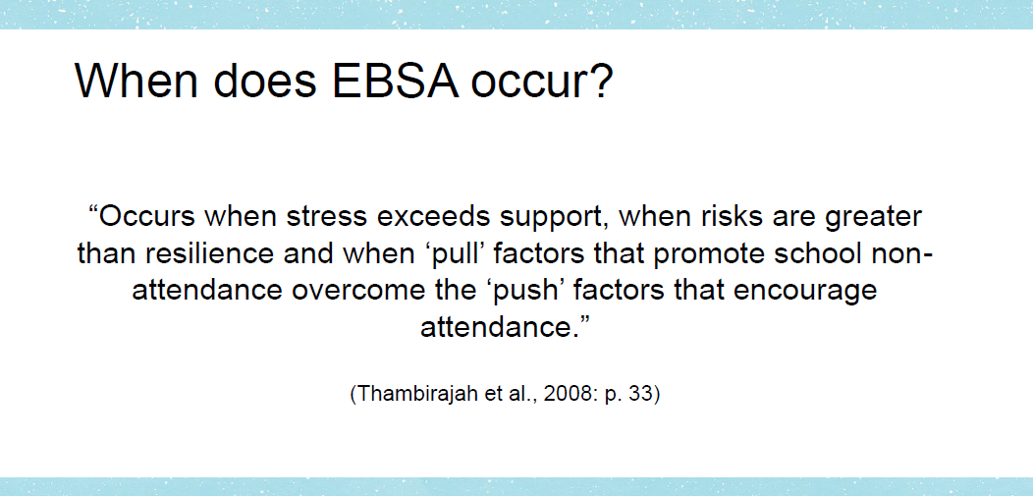

Slide 4
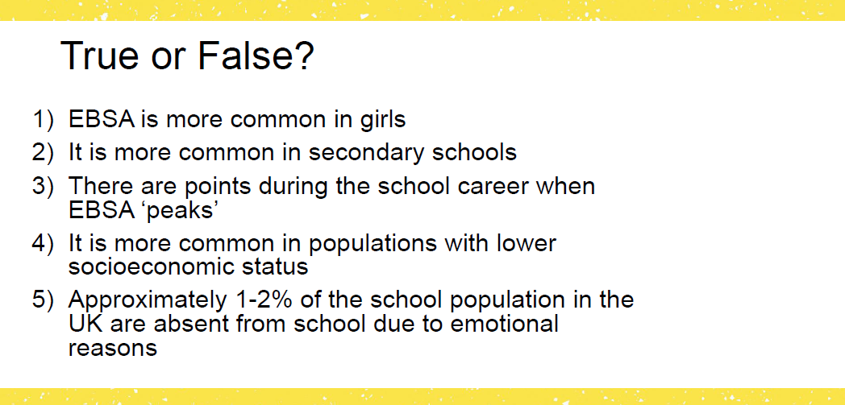

Slide 5
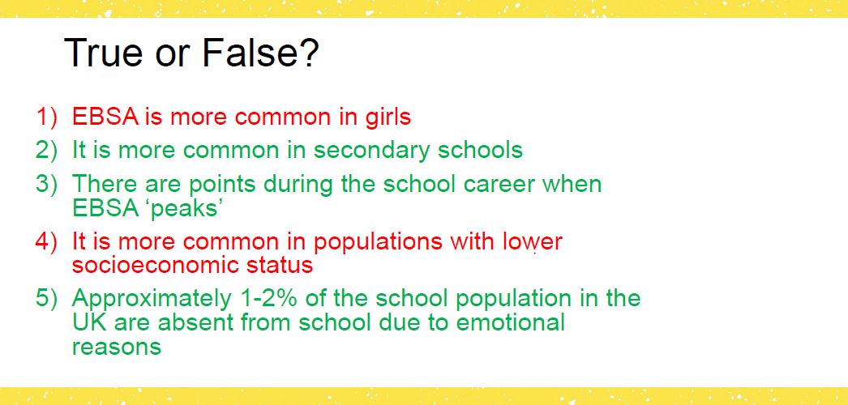

Slide 6
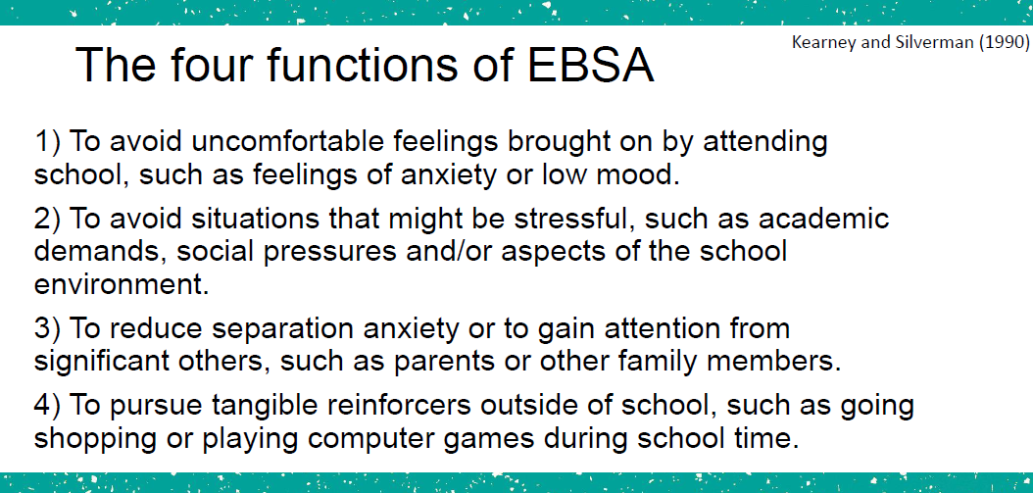

Slide 7
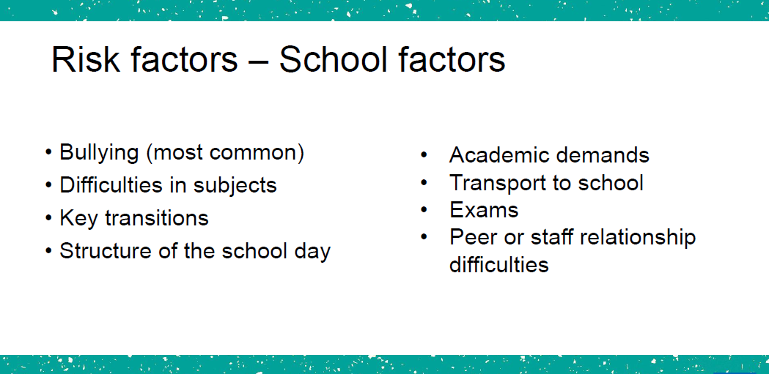

Slide 8
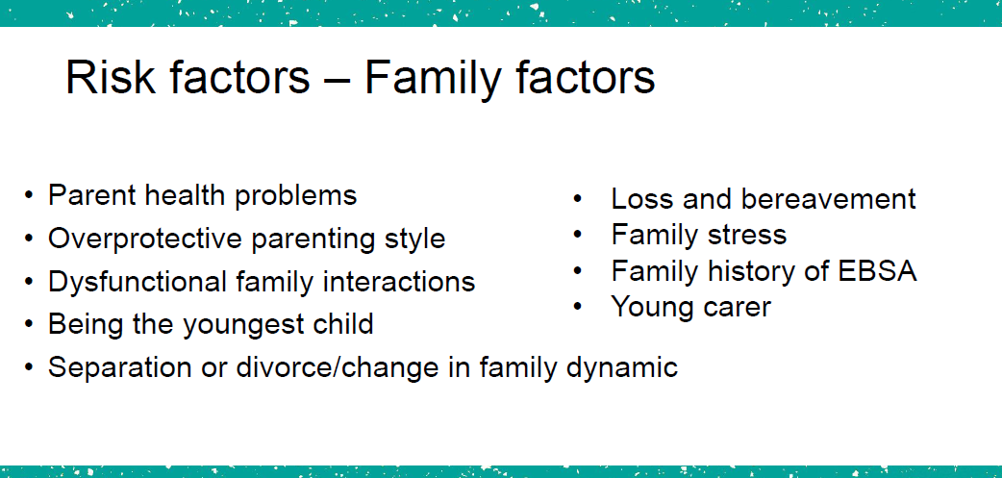

Slide 9
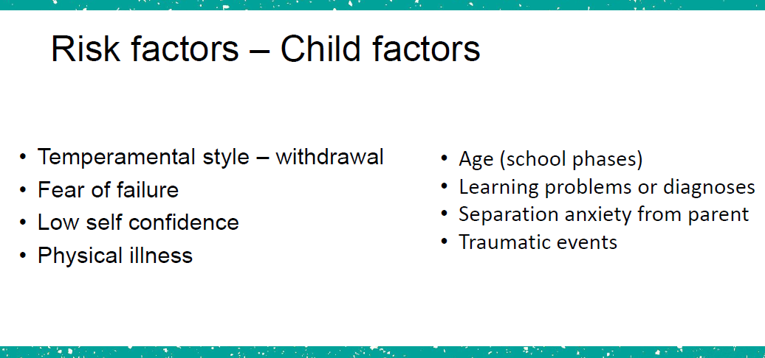

Slide 10
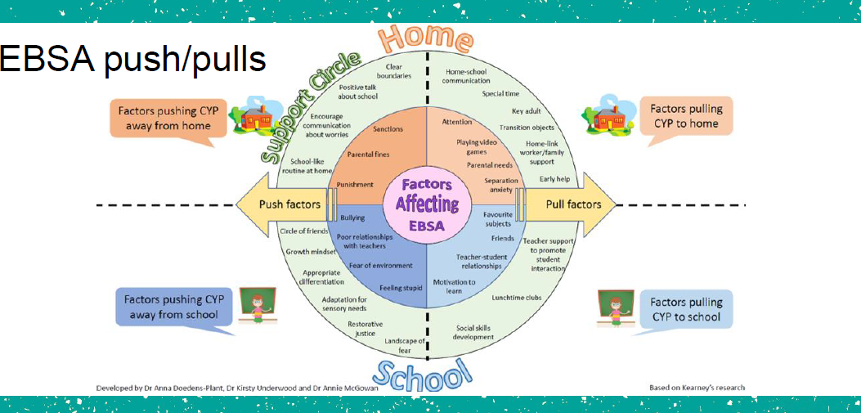

Slide 11
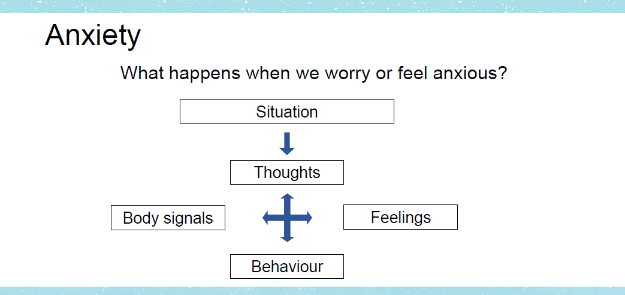

Slide 12
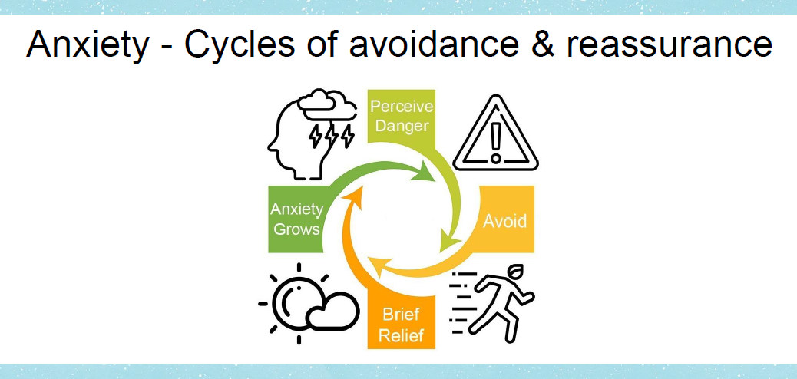

Slide 13
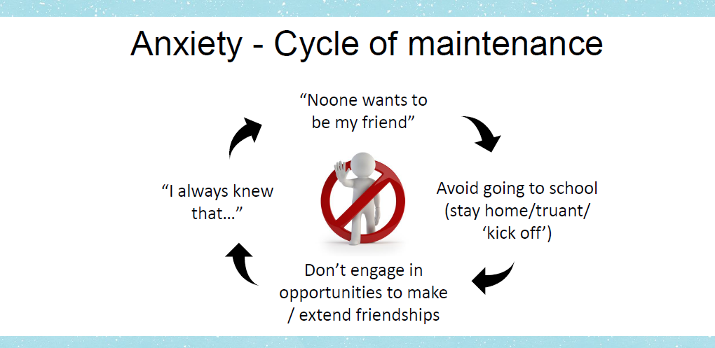

Slide 14
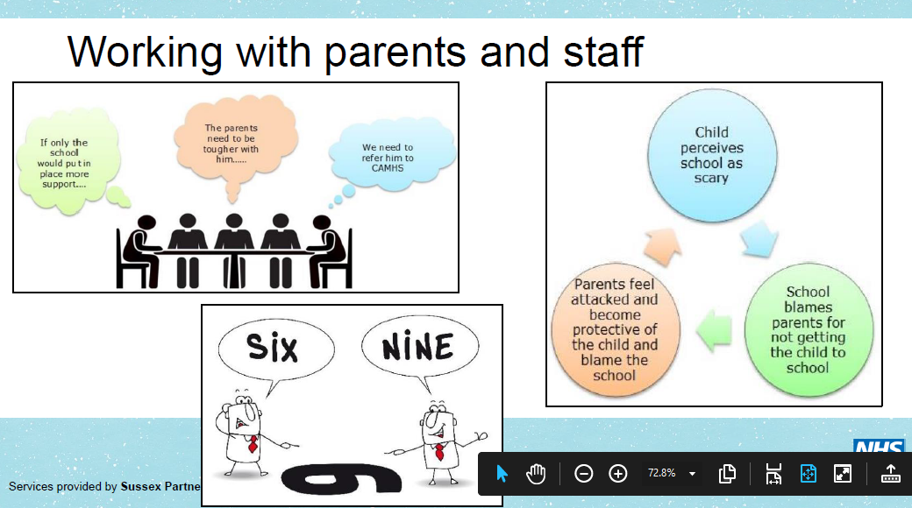

Slide 15
So, what can I do now????
Recognise that if we can actually ride the wave of anxiety (even with varying degrees of support in the first instance), we learn that we can cope. If we keep anxiety going, we never learn how to deal with (what we perceive to be) stressful situations.
Understand that anxiety comes from our natural reaction of fight, flight or freeze – that is normal and it’s there to protect us. However, over time, depression, anxiety and high levels of stress all harm the brain’s ability to slow or cancel false FFF activations, causing them to happen more often.
So, it’s important to share the symptoms of false activation as it makes it easier to recognise and reduce the effects. We therefore ride that wave. The issue is now an achievable feat.
Observe. Record. Talk. Think outside the box.
Eg mornings are stressful….create a checklist/ child agreed responsibilities / they are trusted / they aren’t moaned etc etc….
A comment might have been made eg ‘I’m so old…’ / child worried about you and what might happen….
Little steps – meet and greet on the gate / a morning job / come in with a buddy / come in a different way / a positive goodbye / share your days / invisible string / an object from home / make a plan for after school…..
anxiety video

